Slide 1

Mobile Serverless Computing – results analysis
29 May 2023
Jan Ściga

Slide 2
Analysis Introduction
10 series of simulations based on IEEE articles & own ideas for a performance analysis
Most of the simulations assumed 2 configuration scenarios to examine also memory allocation impact as the main configurable (and crucial for a billing !) parameter for a user
Apache JMeter tool used for a vendor-independent performance testing
General Remarks:
simplifications (we are also using metrics delivered by the cloud providers, avoiding simulation multiple runs in fear of a billing, not fully aware of all optimizations used by the clouds)
AWS/GCP & GCP solietary testing
analysis includes both business and technical perspective for a cloud end-user

Slide 3
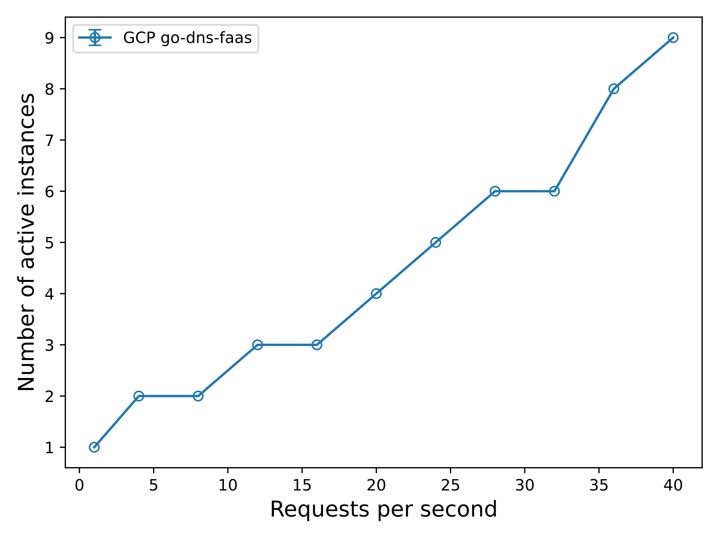
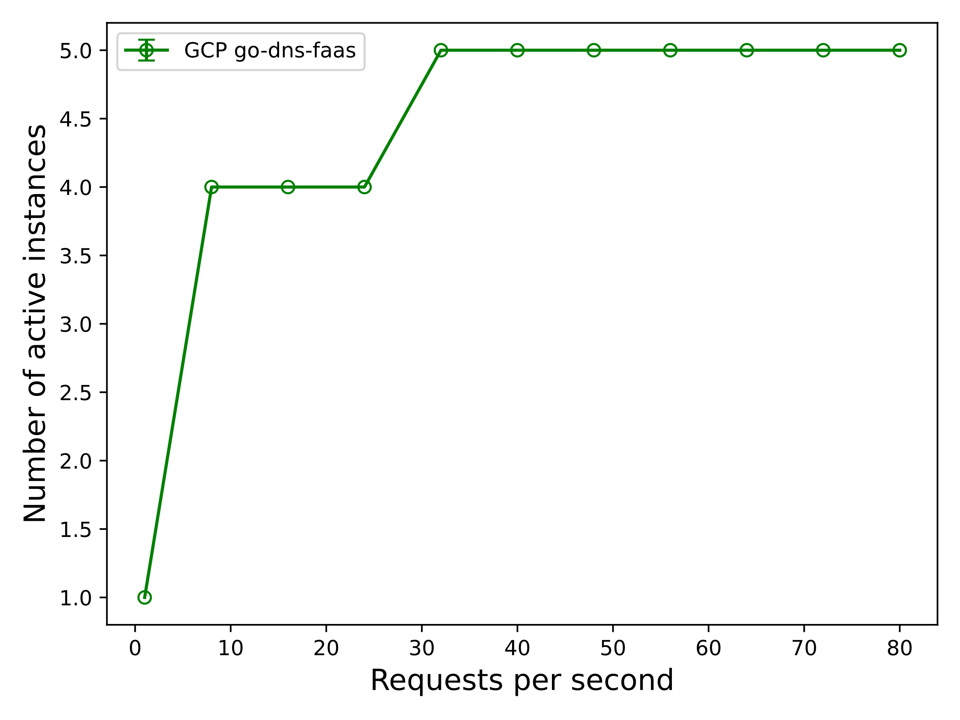
Serverless Faas Scaling
#ConclusionPack1 – No difference between GCP generations in terms of faas scaling, shock effect often visible, more allocation resources for a large memory deployments

Slide 4
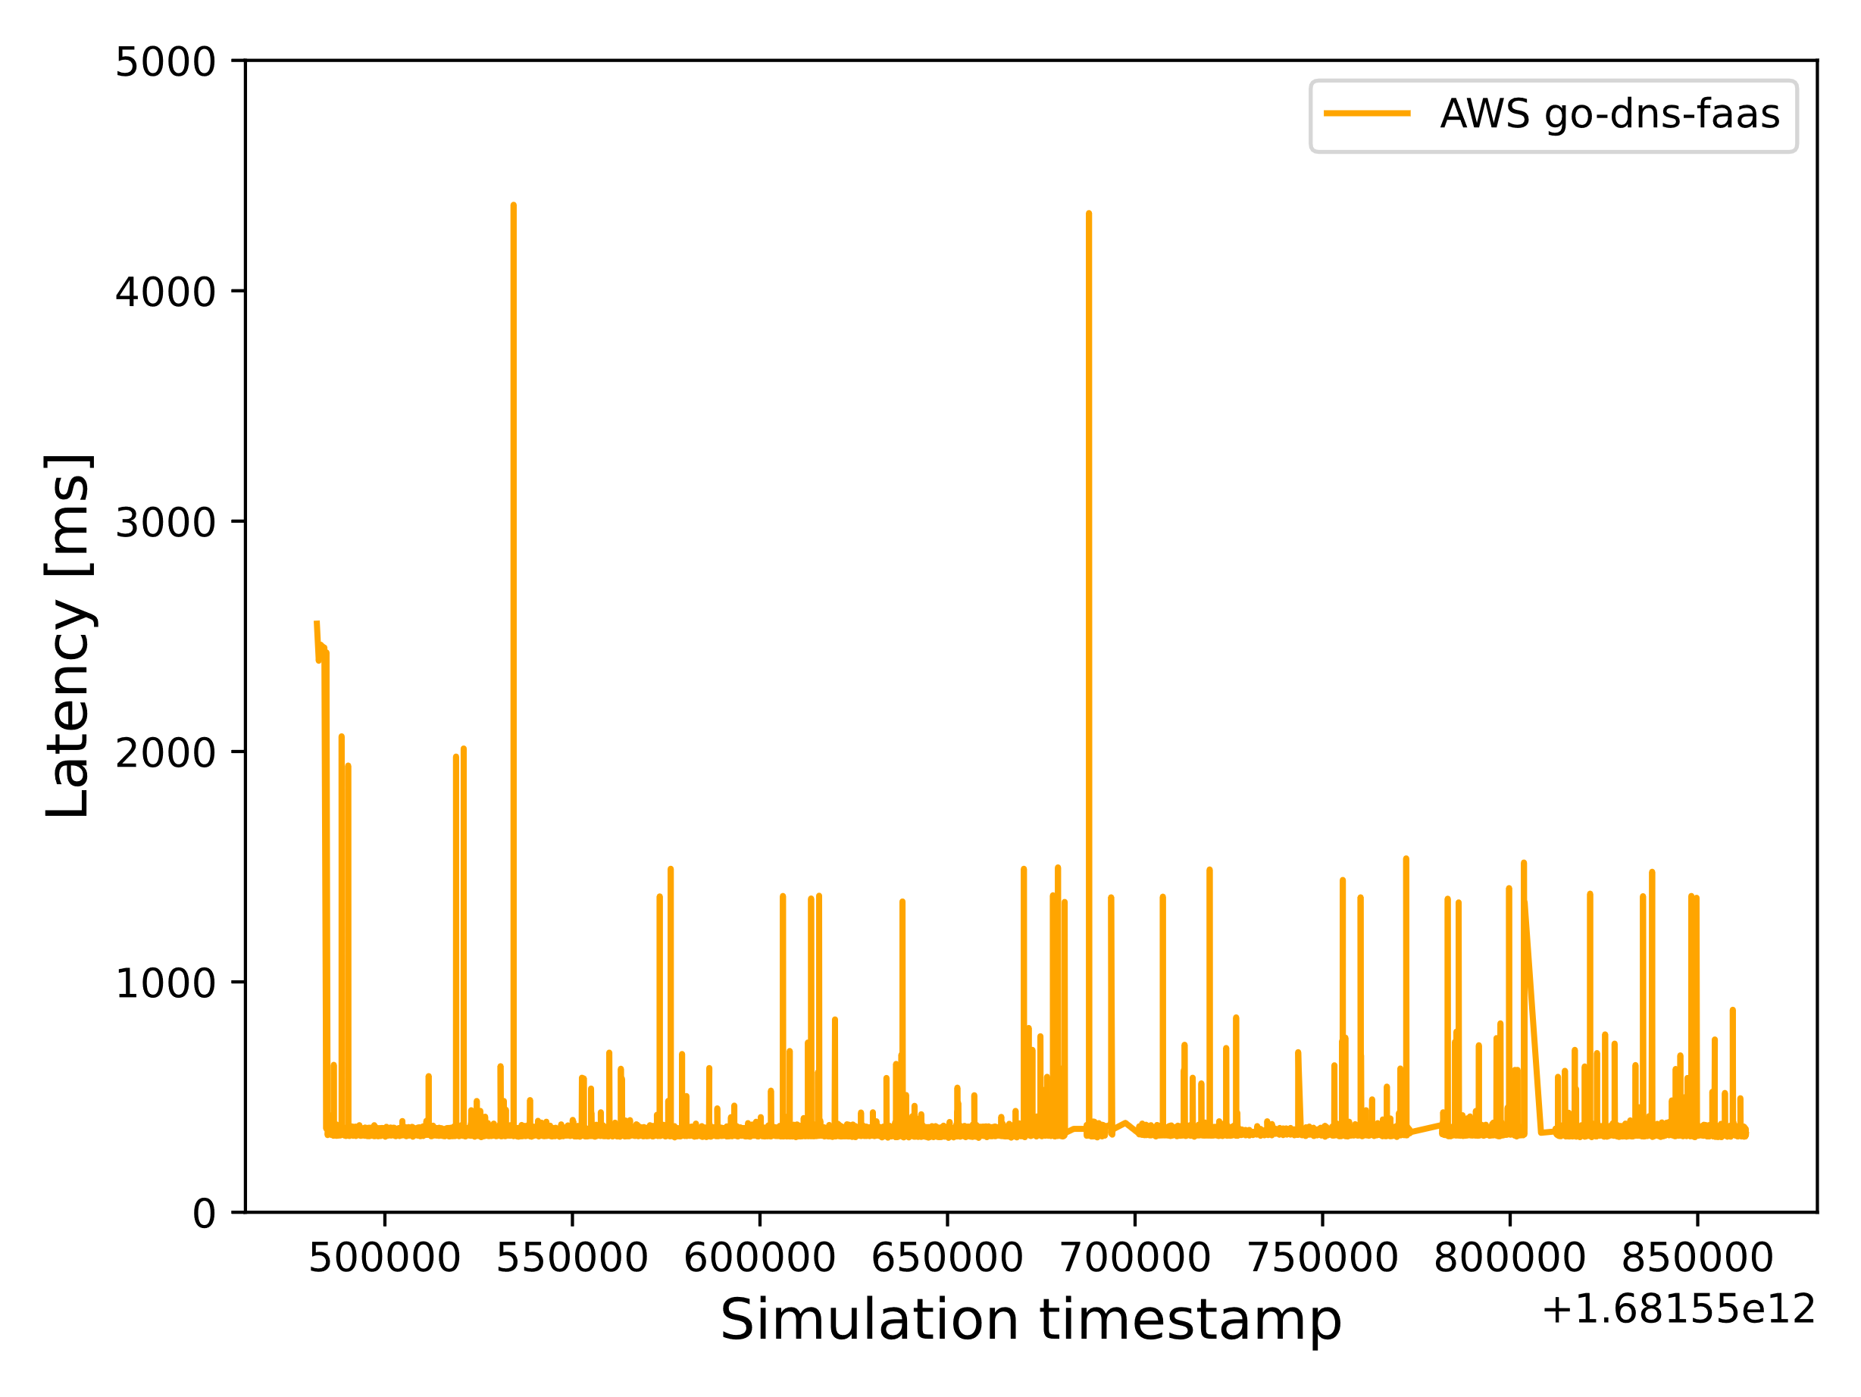
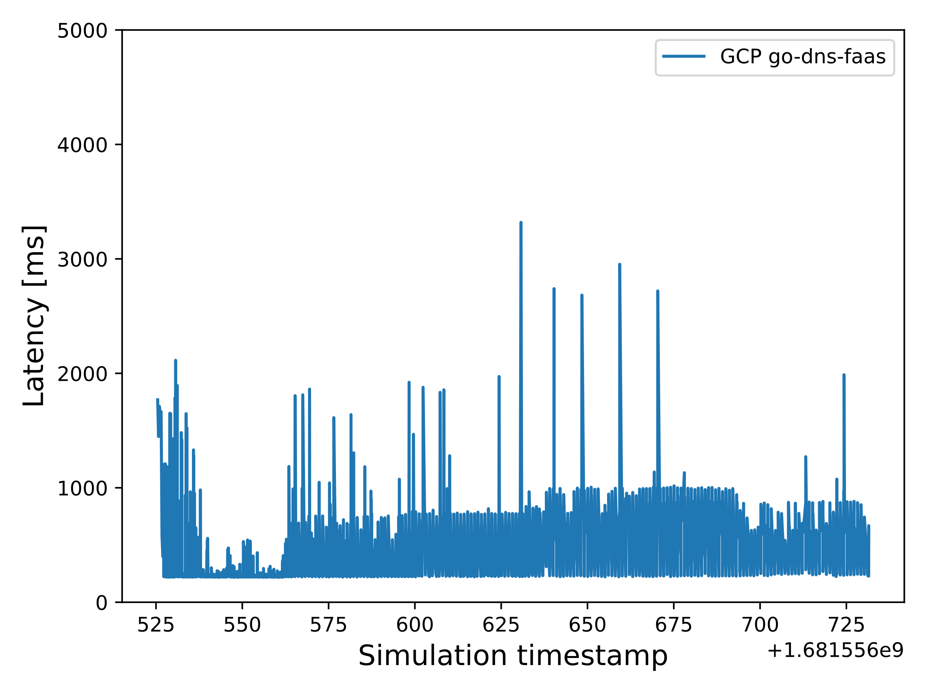
Cold Start
#ConclusionPack2 – Cold start lasts longer in small allocations (less resources), AWS scheduler performs better, cold start accumulated in the first phase of the simulations

Slide 5
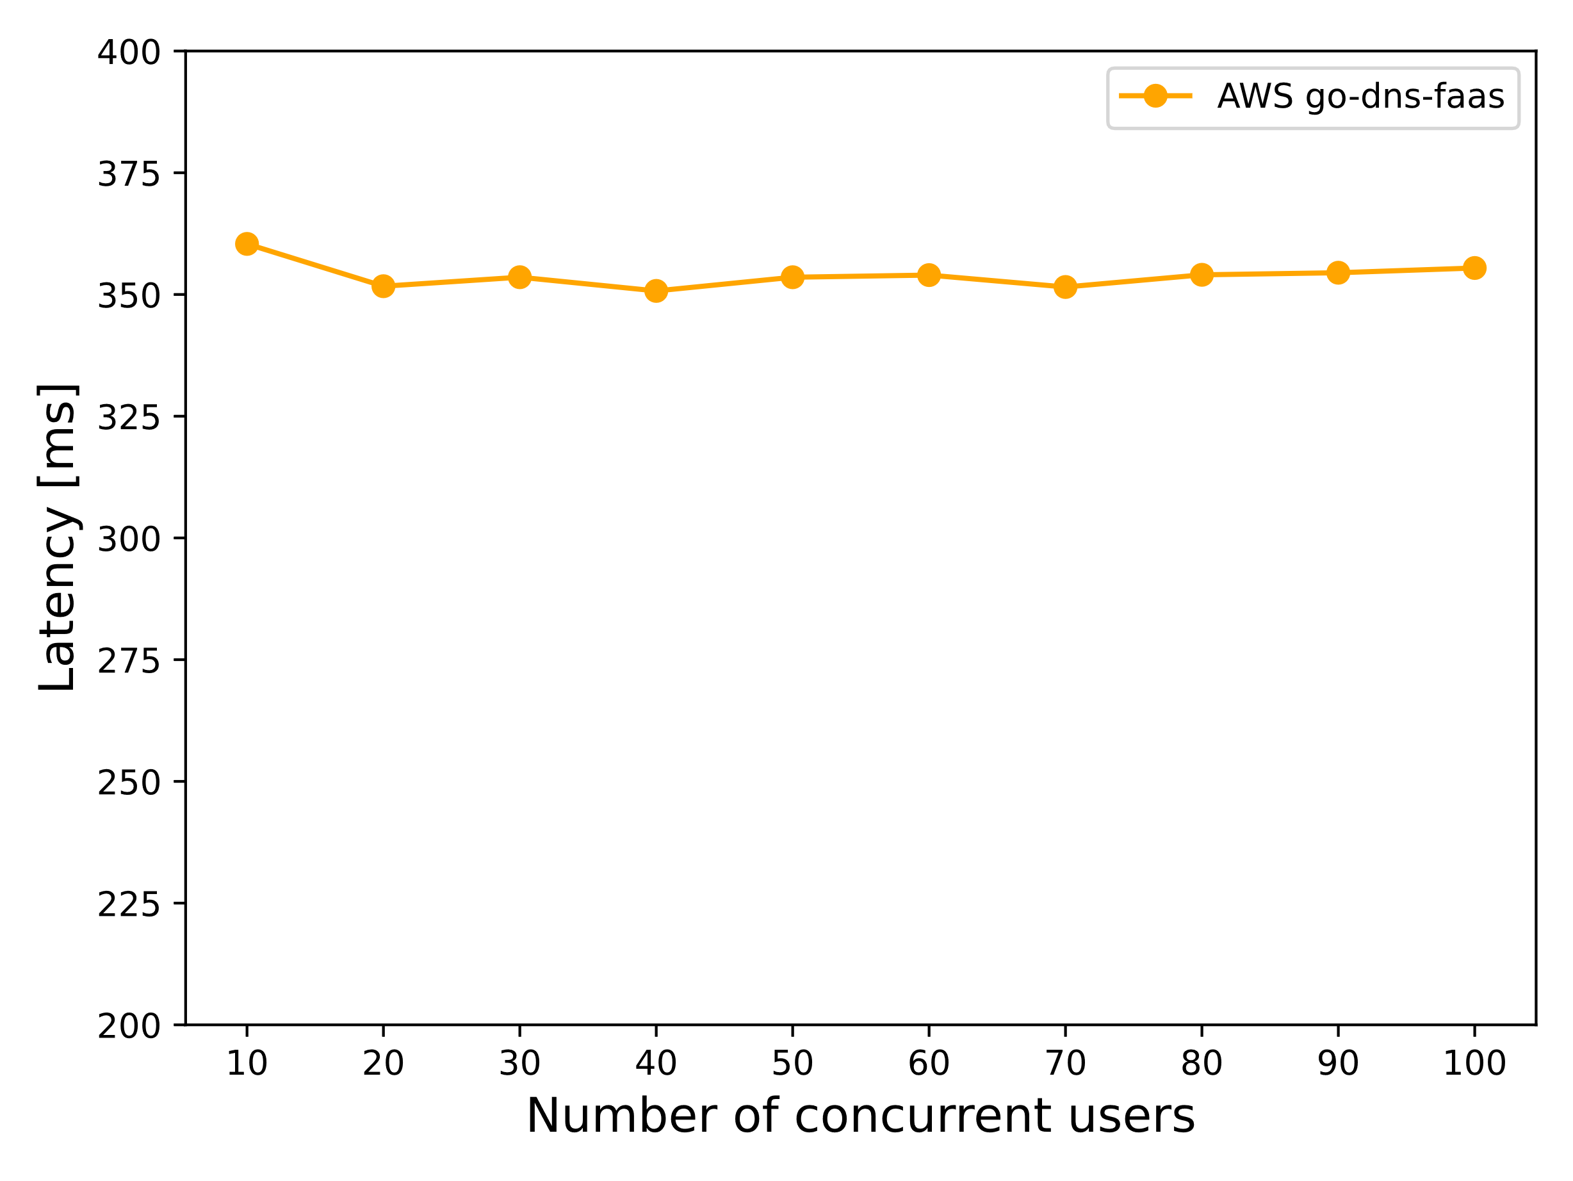

AWS Cold Start Revisited

Slide 6
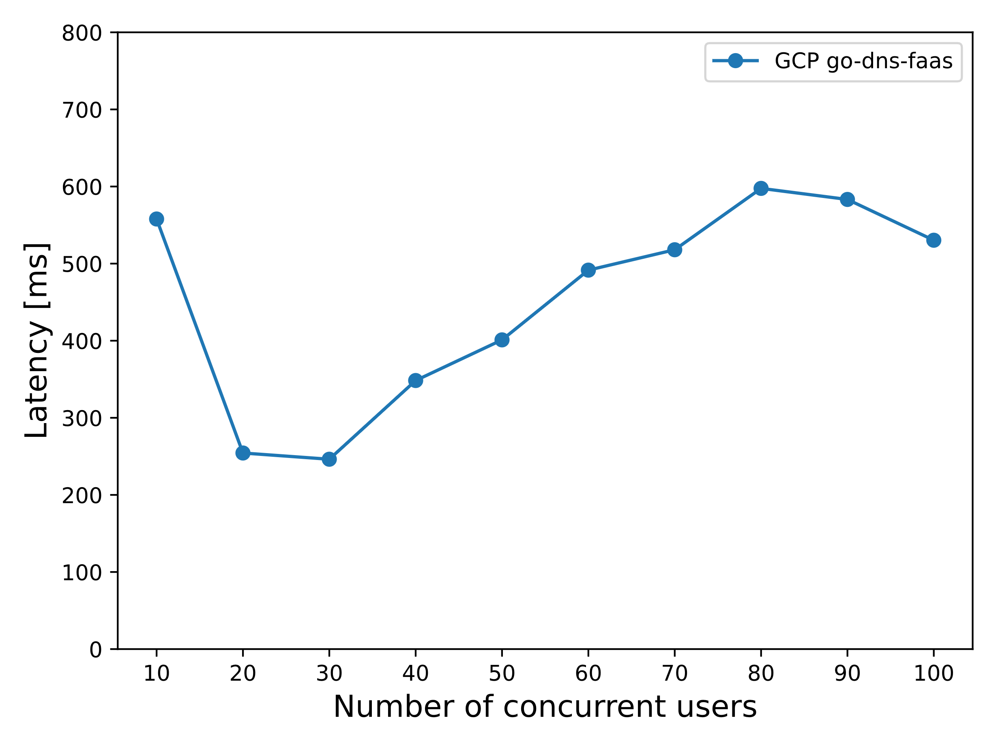
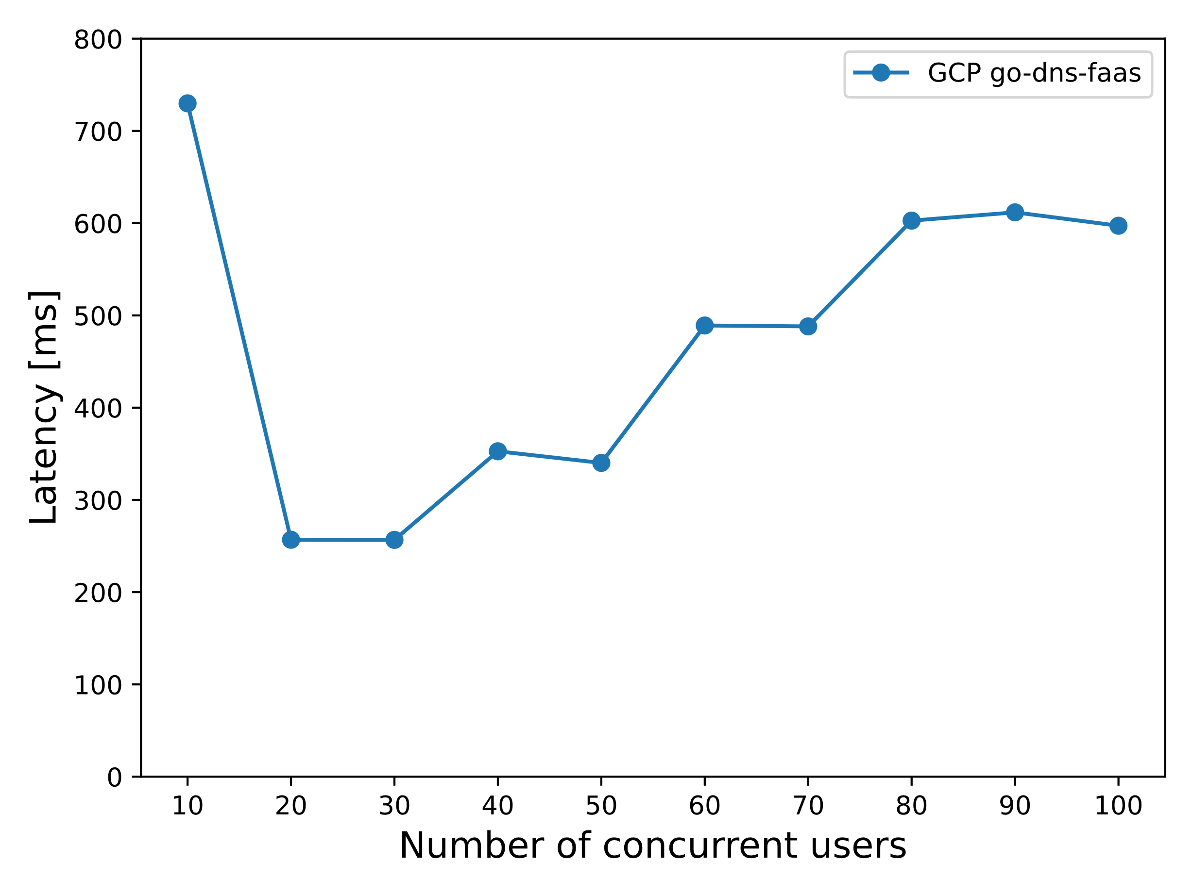
GCP Cold Start Revisited
#ConclusionPack3 – Cold Start affecting mostly in the first stage, constant latency in AWS despite load increase, deep dives in case of less memory allocation scenarios (esp. GCP)

Slide 7
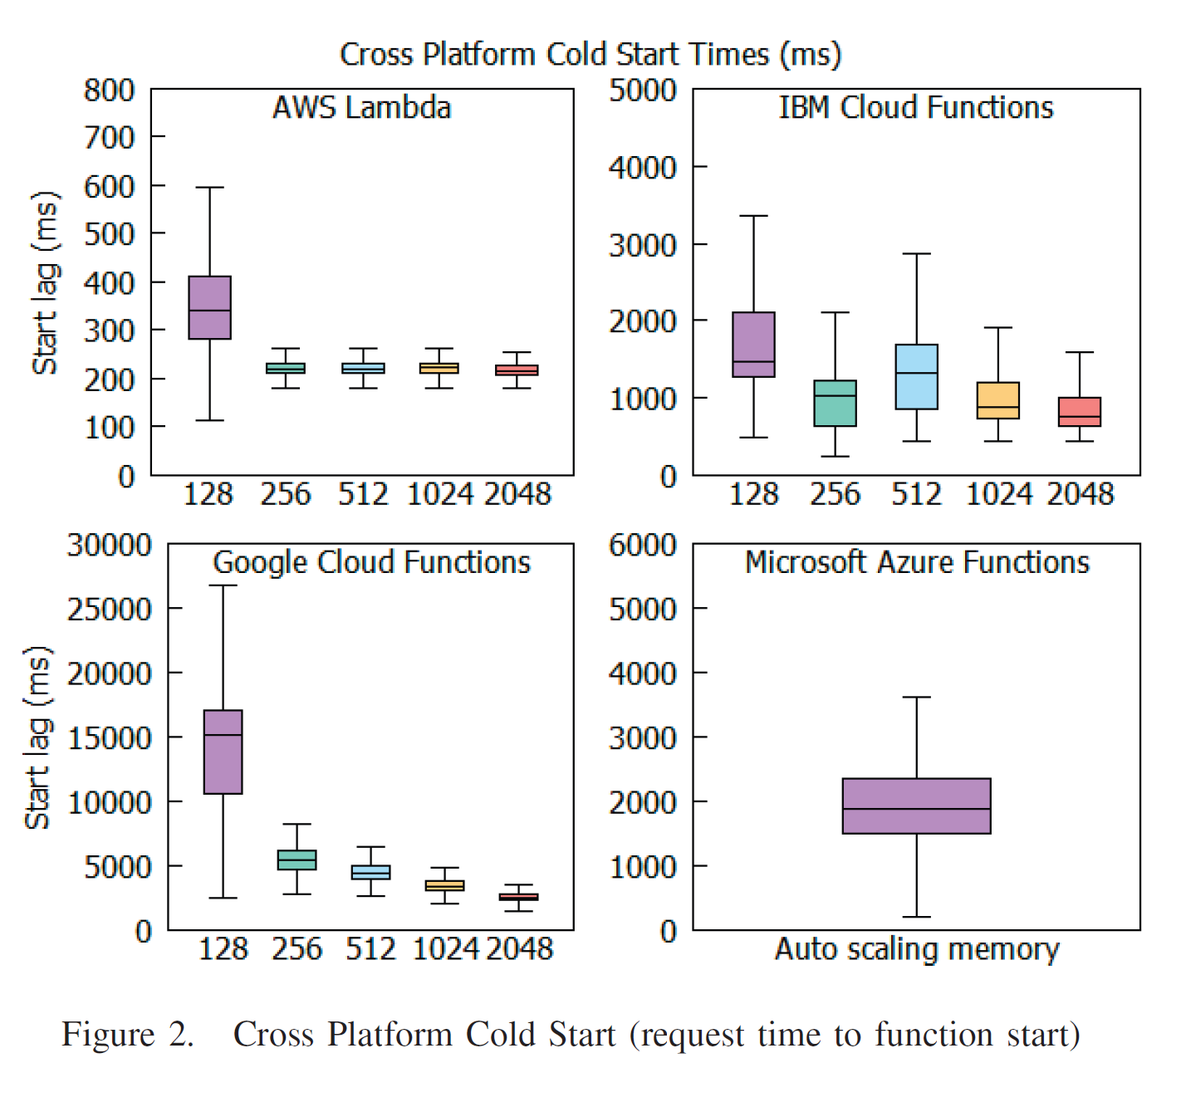
#1 IEEE Explorer verification inspection
D. Kelly, F. Glavin and E. Barrett, "Serverless Computing: Behind the Scenes of Major Platforms," 2020 IEEE 13th International Conference on Cloud Computing (CLOUD), Beijing, China, 2020, pp. 304-312, doi: 10.1109/CLOUD49709.2020.00050.

Slide 8
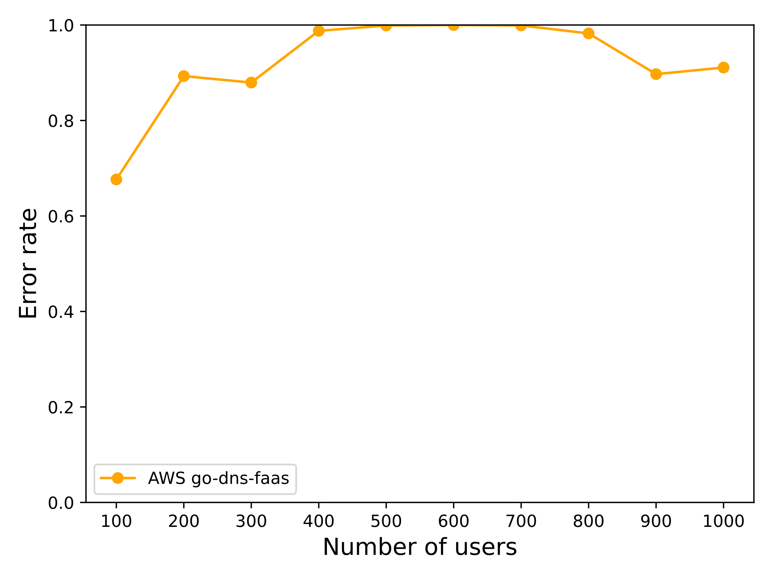
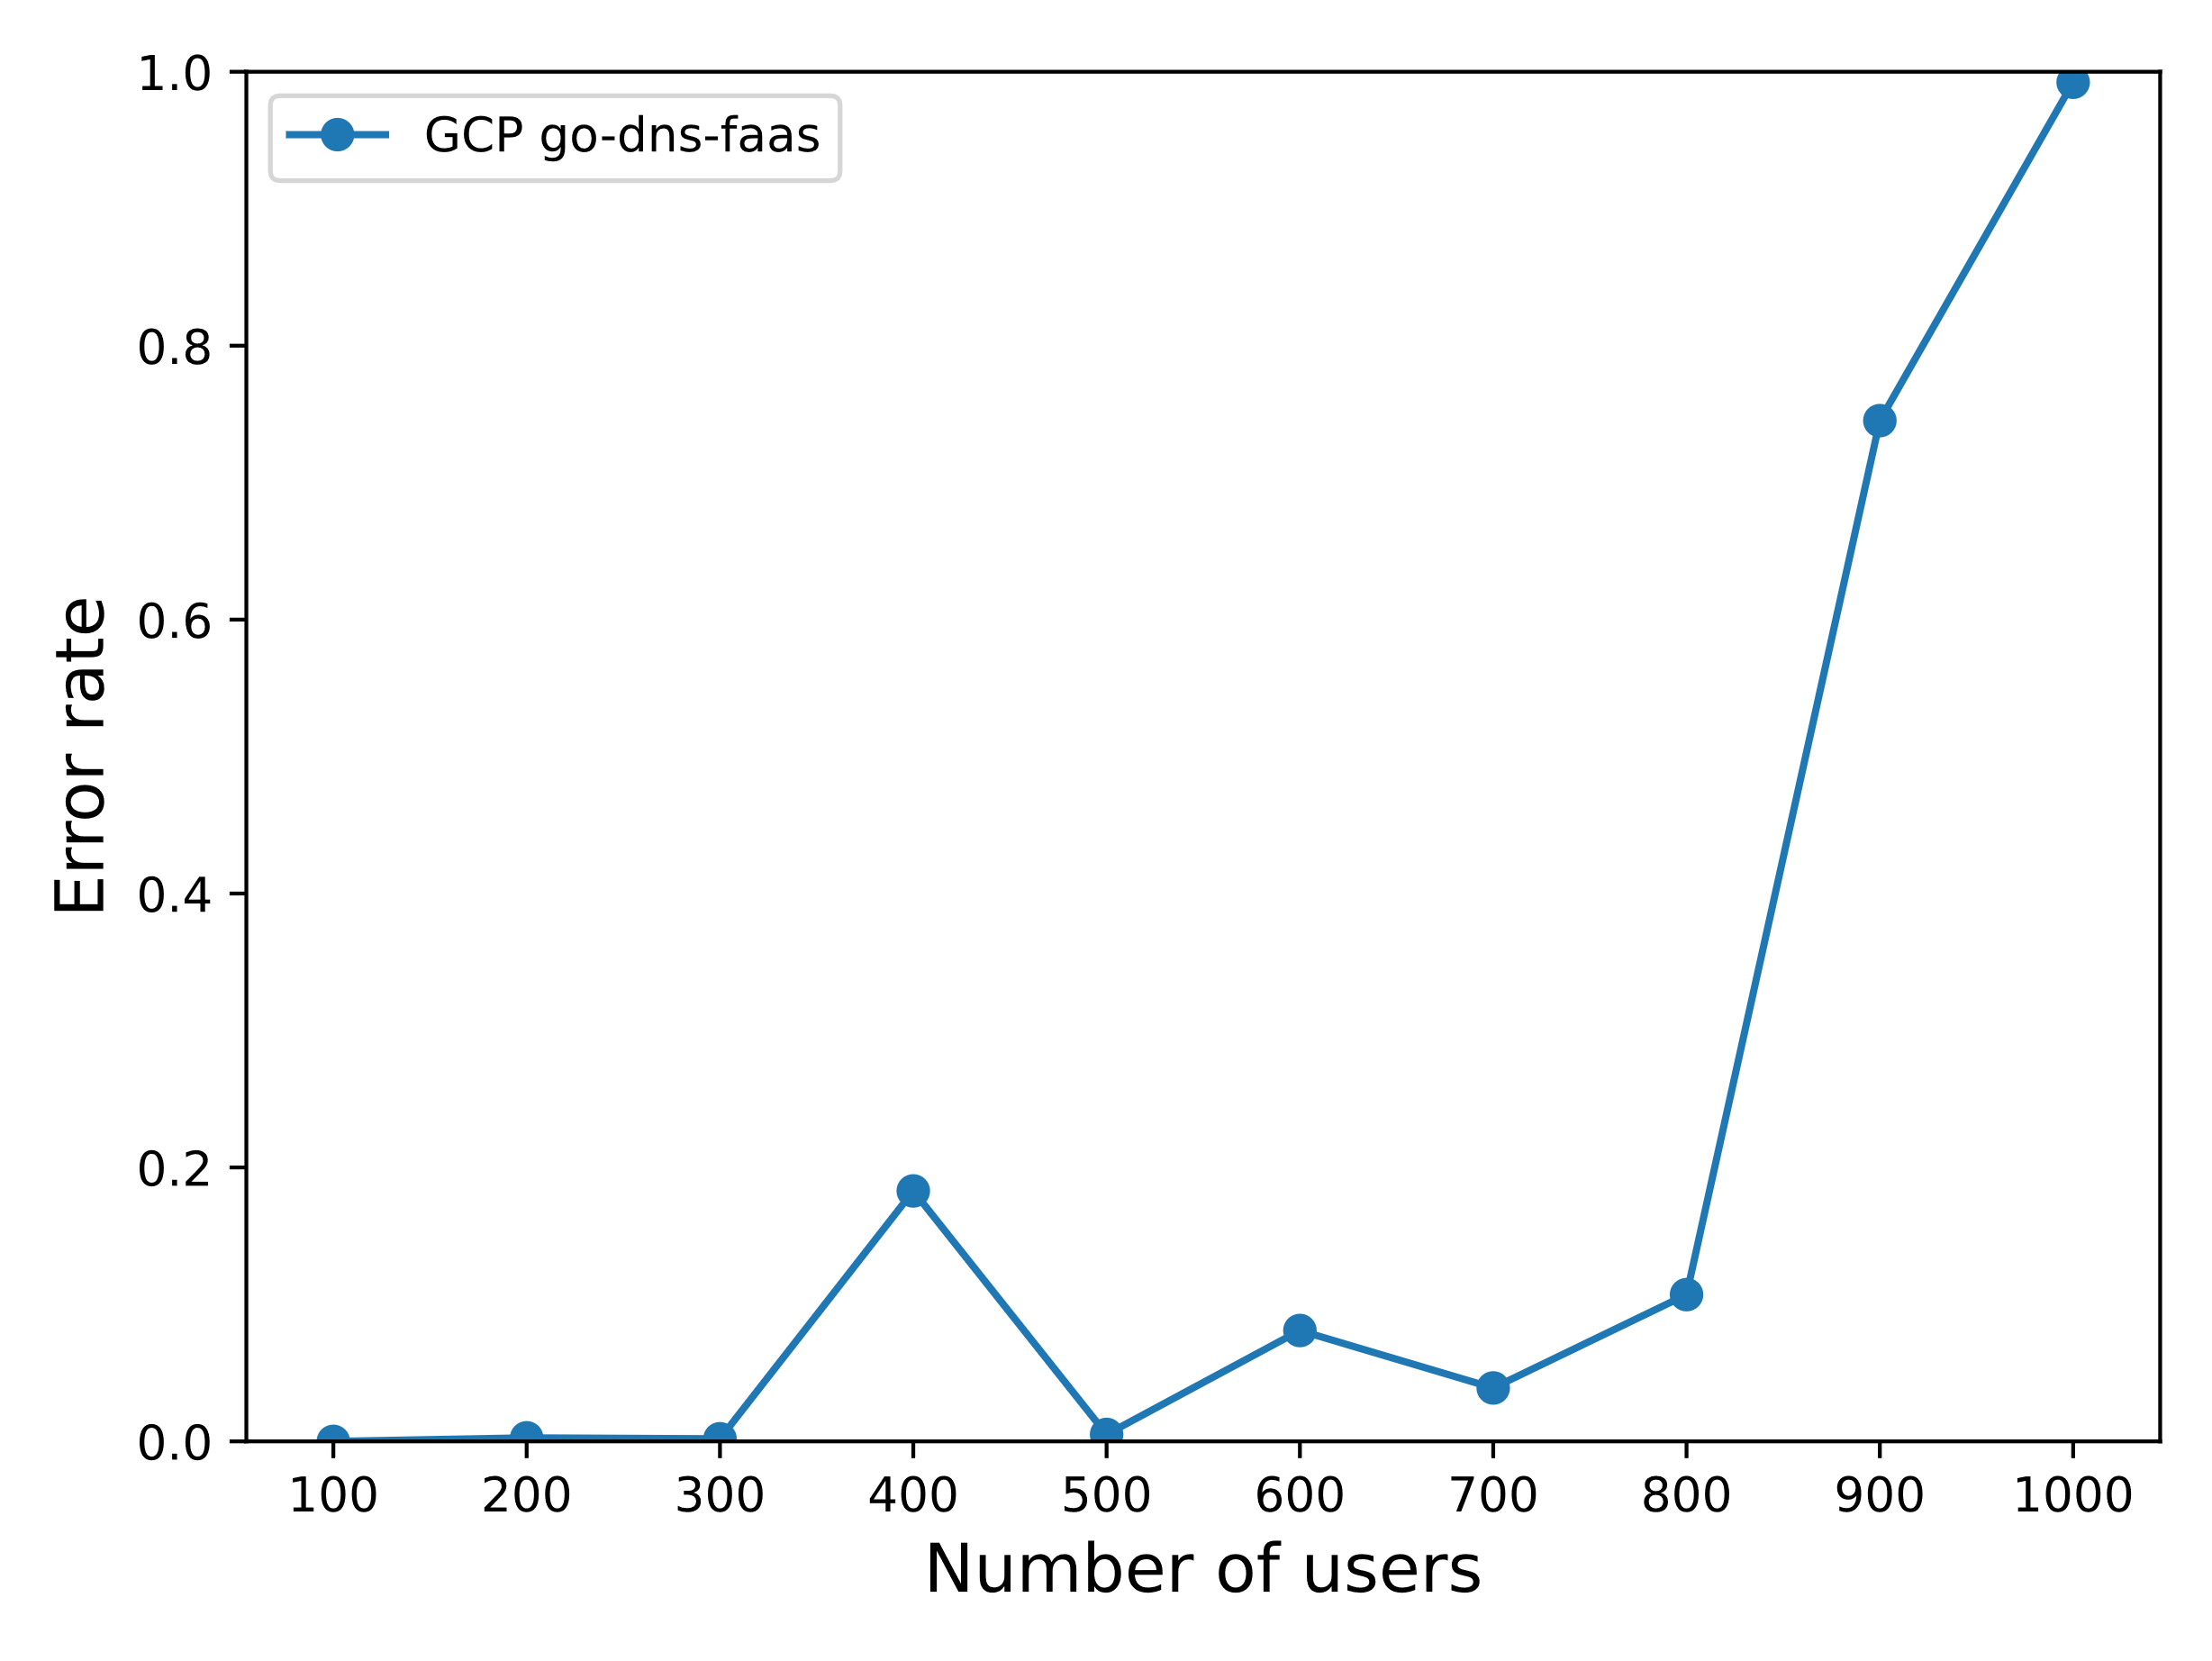
Service Availability/Shock Sensivity Analysis
#ConclusionPack4 – Max number of instances impacting the simulation results; no visible difference in terms of a memory allocation comparison; high unpredictability of results

Slide 9
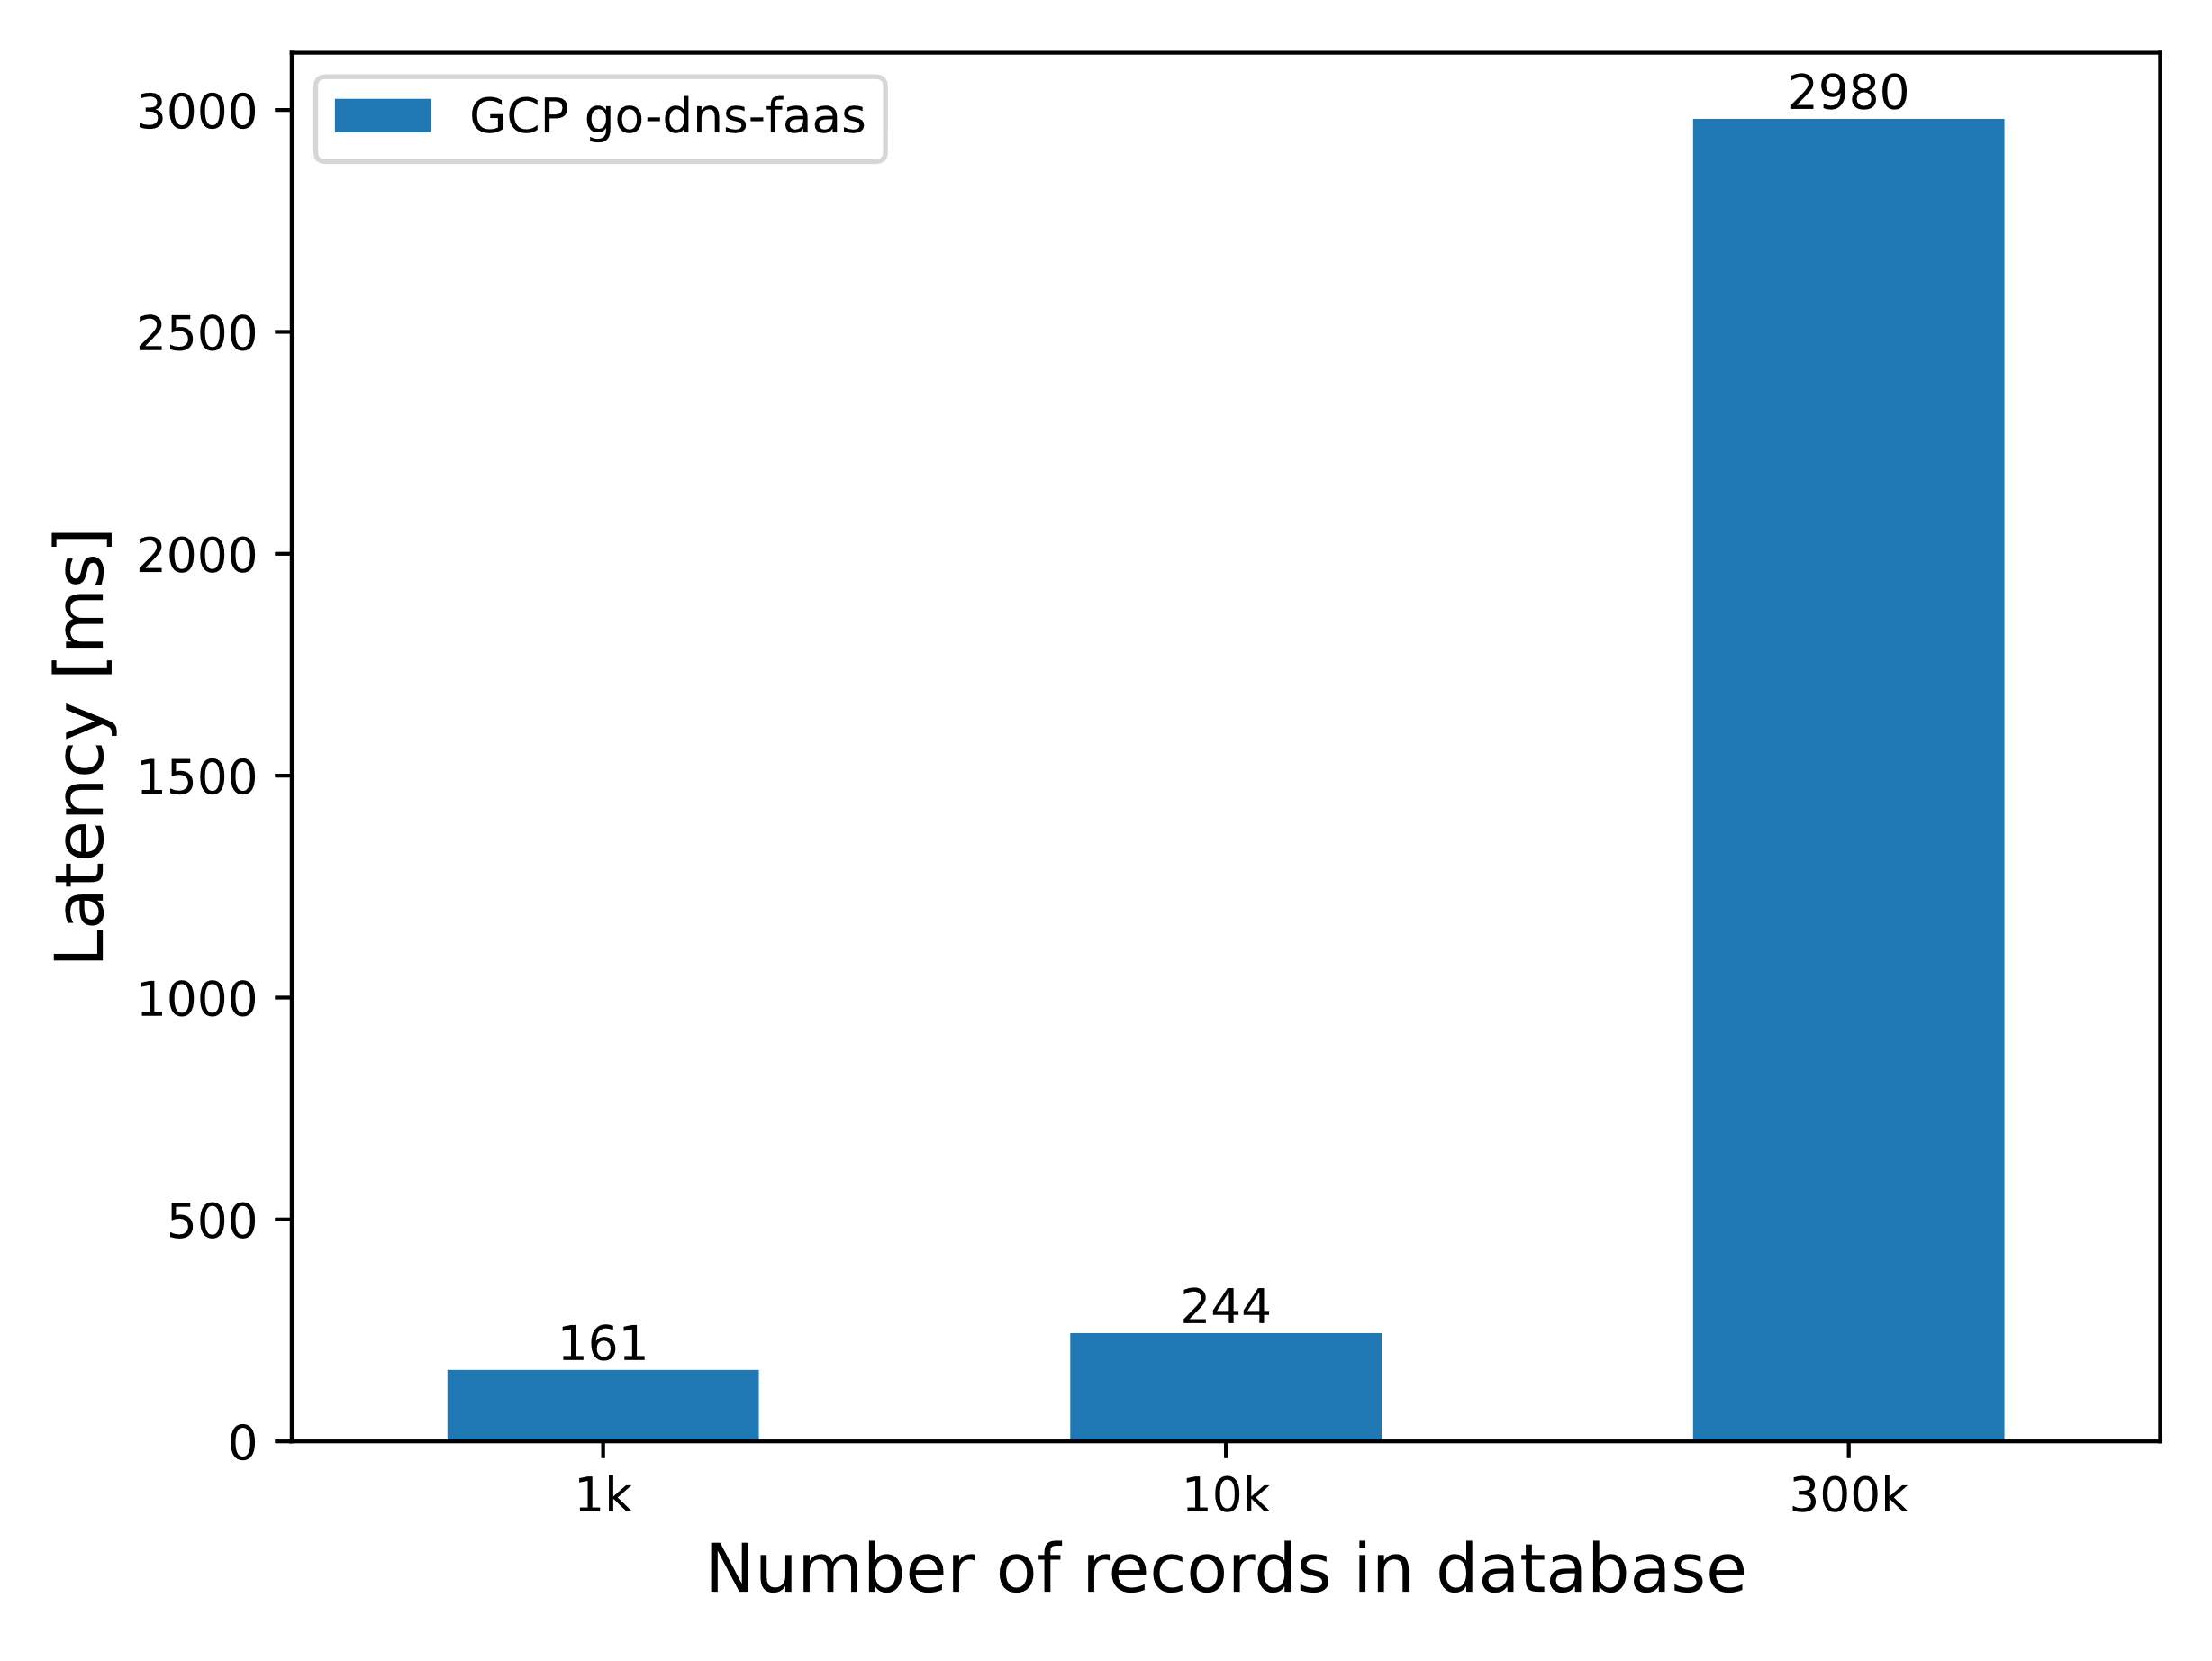
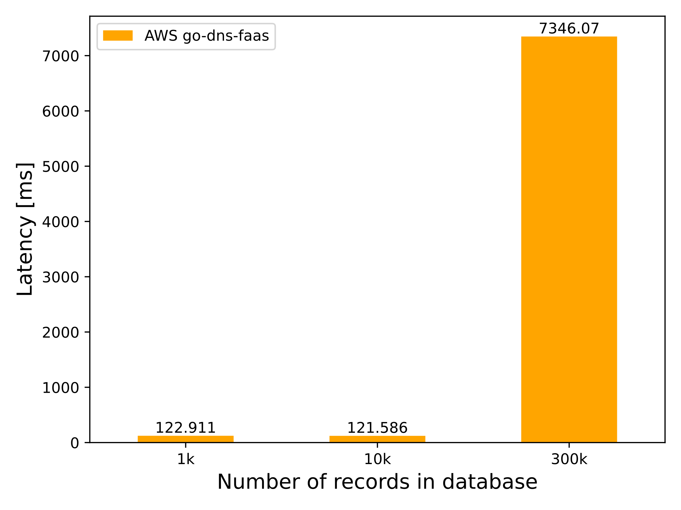
Database Memory Analysis
#ConclusionPack5 – Lower latencies for a lower number of records in DB for AWS; significantly larger for AWS during high number of records case; important factor specific for serverless DNS

Slide 10
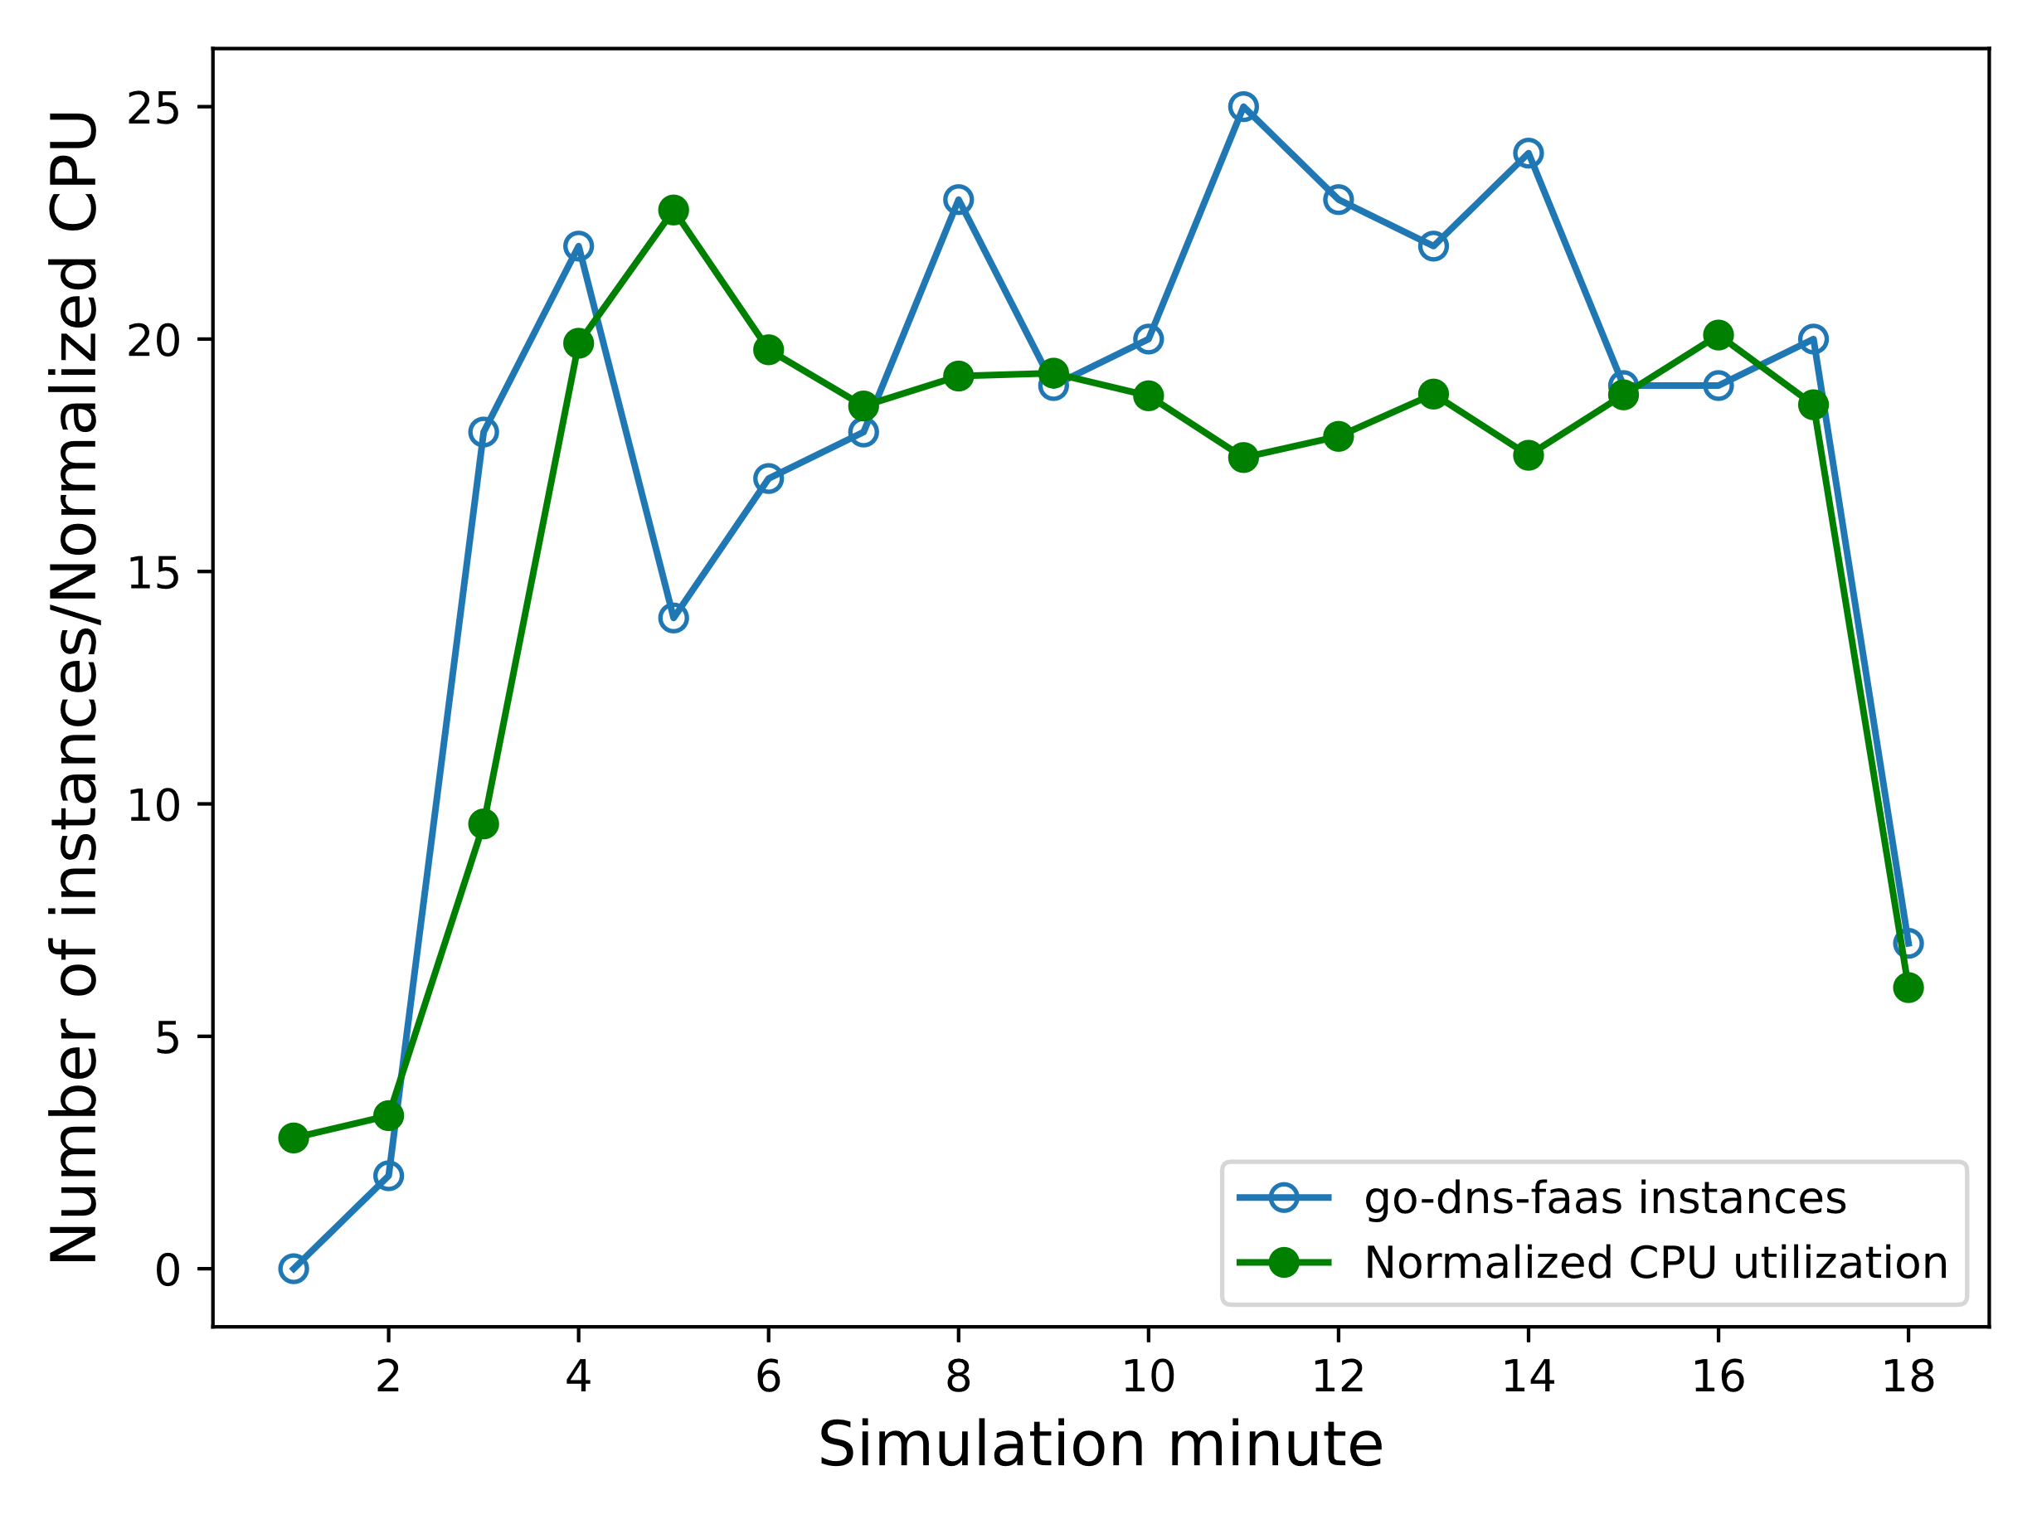
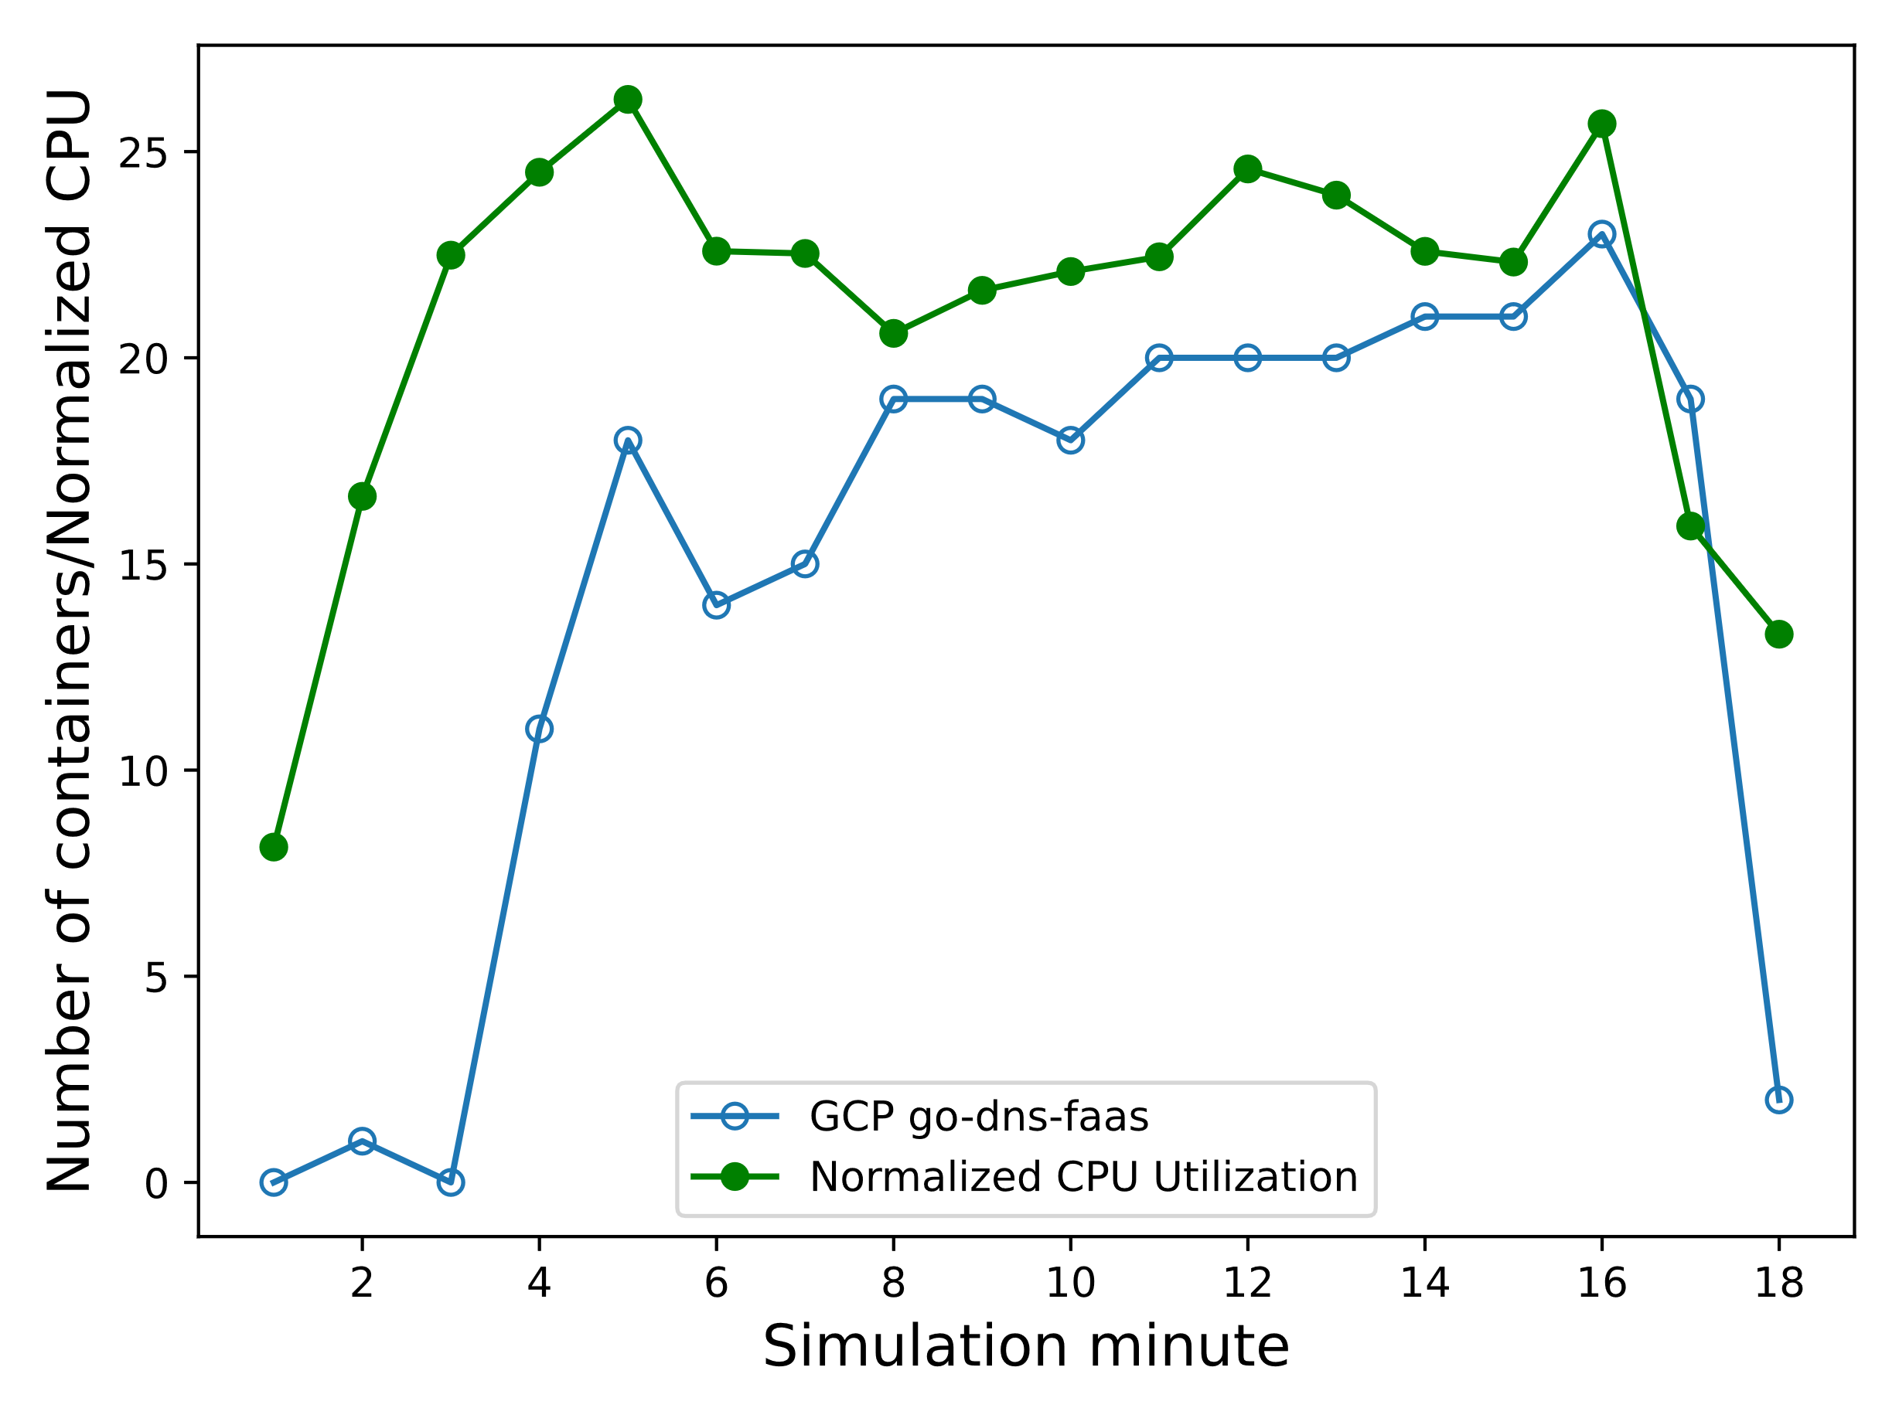
CPU Utilization with no. of instances
#ConclusionPack6 – Number of GCP Function instances strictly follows CPU utilization; Large granularity of AWS reports; around 10 times more resources for the bigger allocation

Slide 11
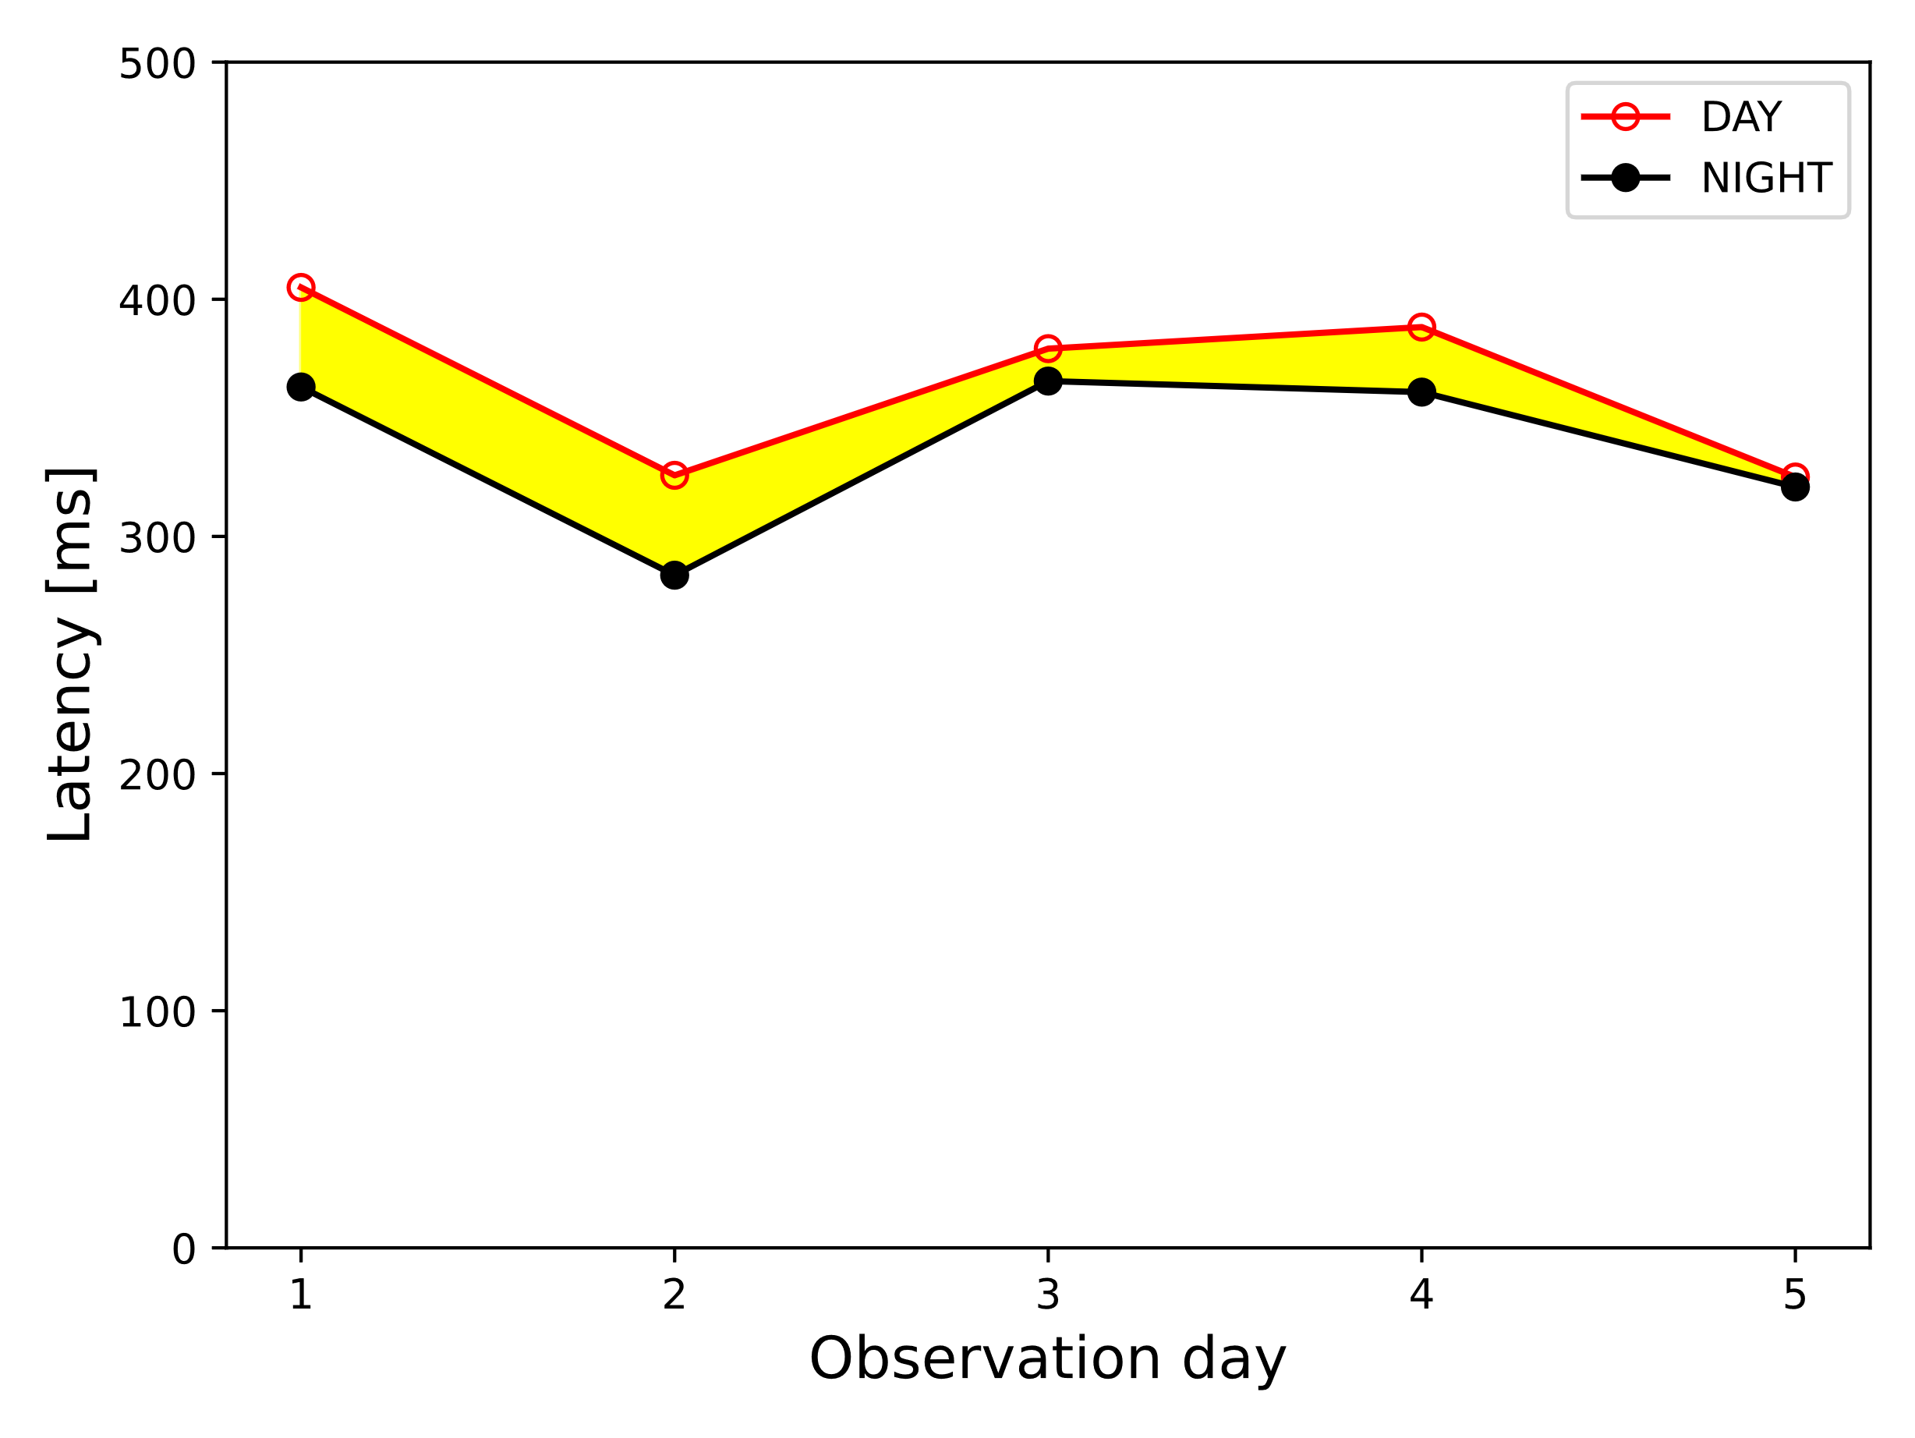
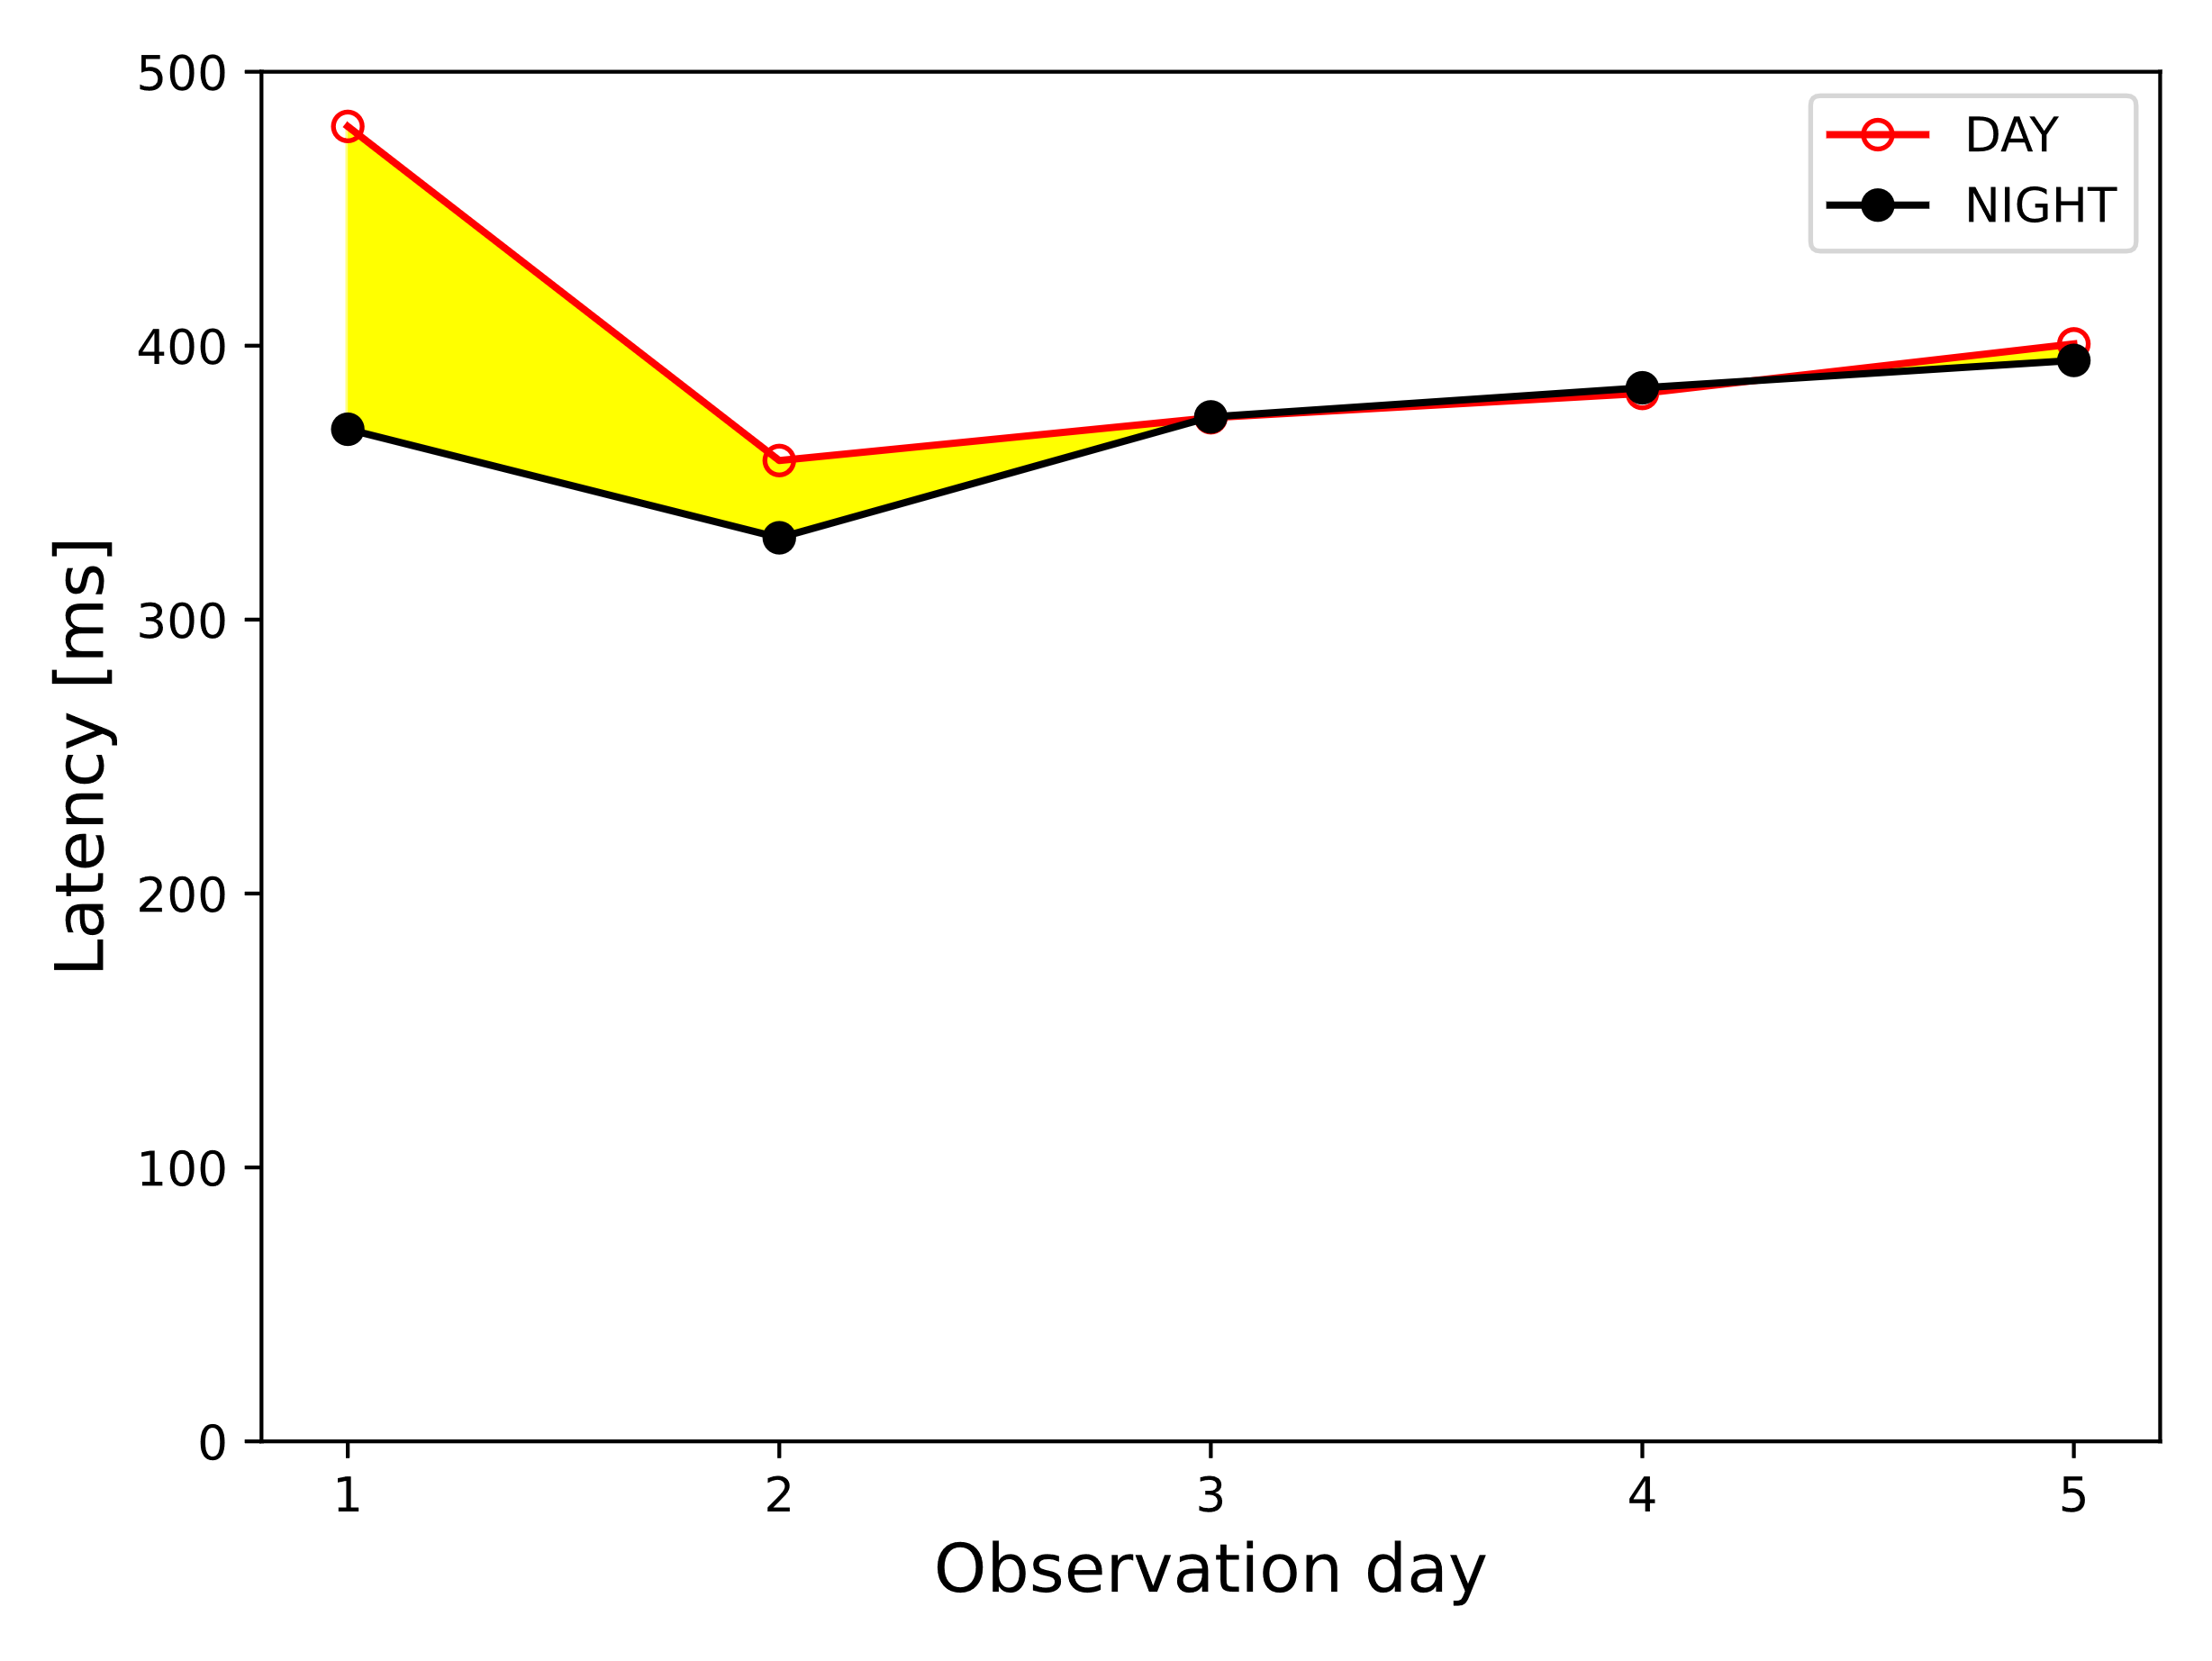
Interference Effect on Performance
#ConclusionPack7 – Interference effect of the high intensity traffic during the day is noticeable in some scenarios; important aspect for latency vulnerable applications and pricing

Slide 12
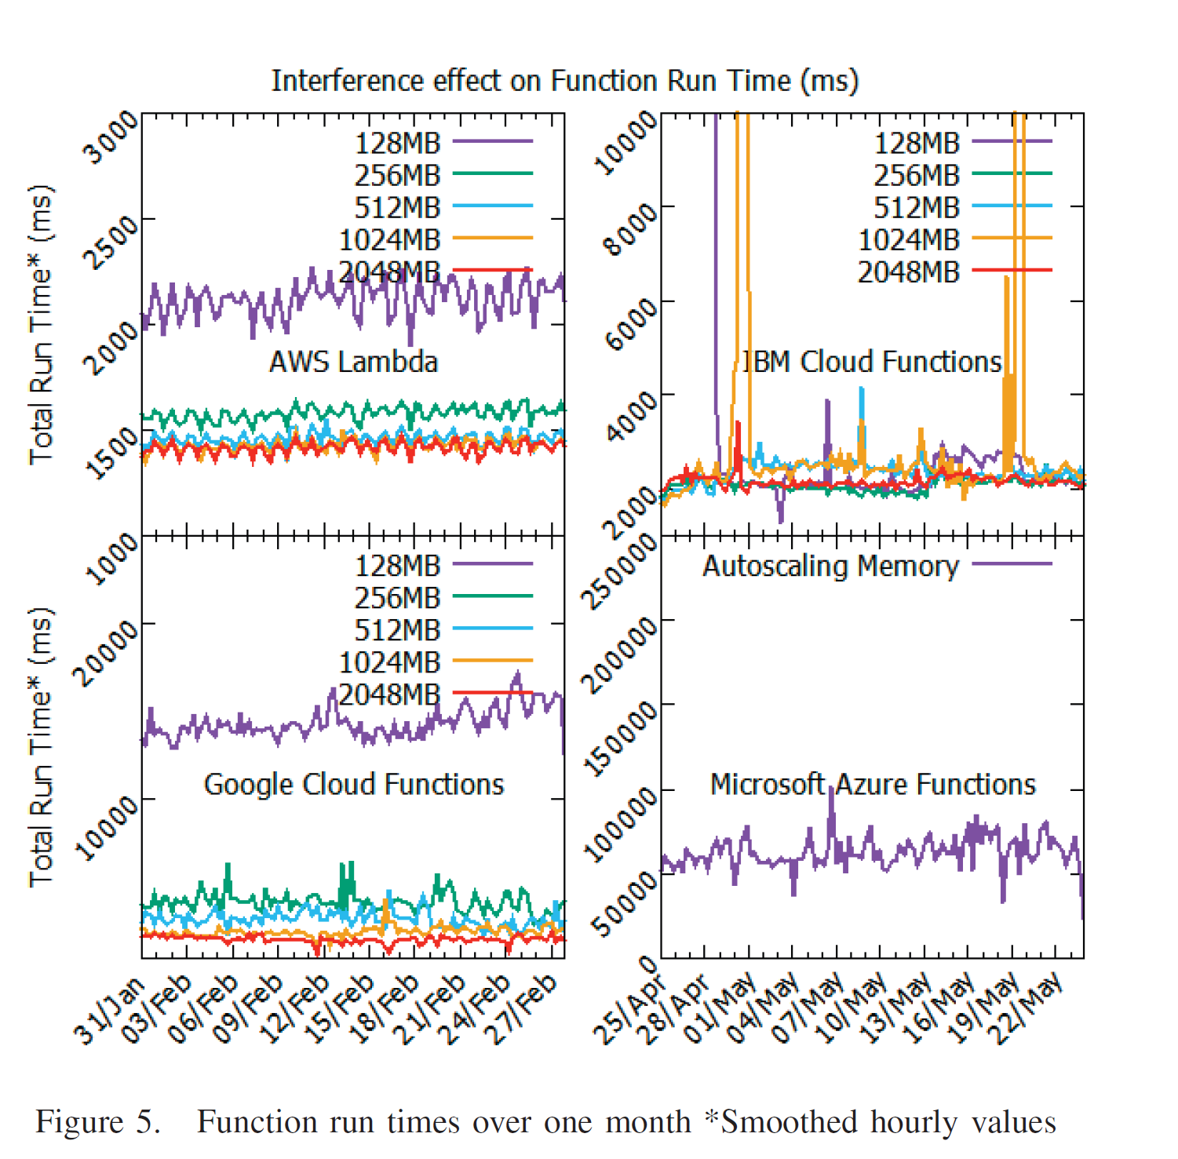
#2 IEEE Explorer verification inspection
D. Kelly, F. Glavin and E. Barrett, "Serverless Computing: Behind the Scenes of Major Platforms," 2020 IEEE 13th International Conference on Cloud Computing (CLOUD), Beijing, China, 2020, pp. 304-312, doi: 10.1109/CLOUD49709.2020.00050.

Slide 13
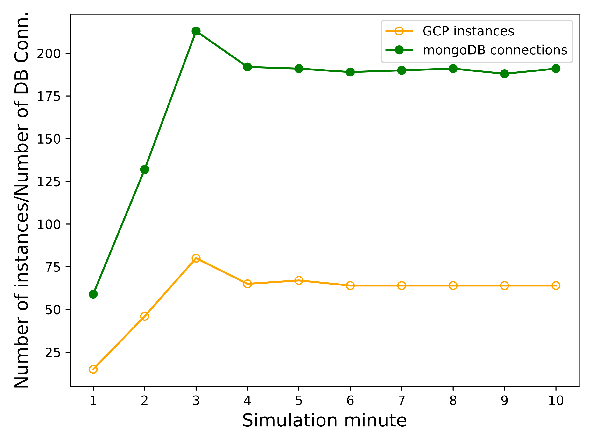
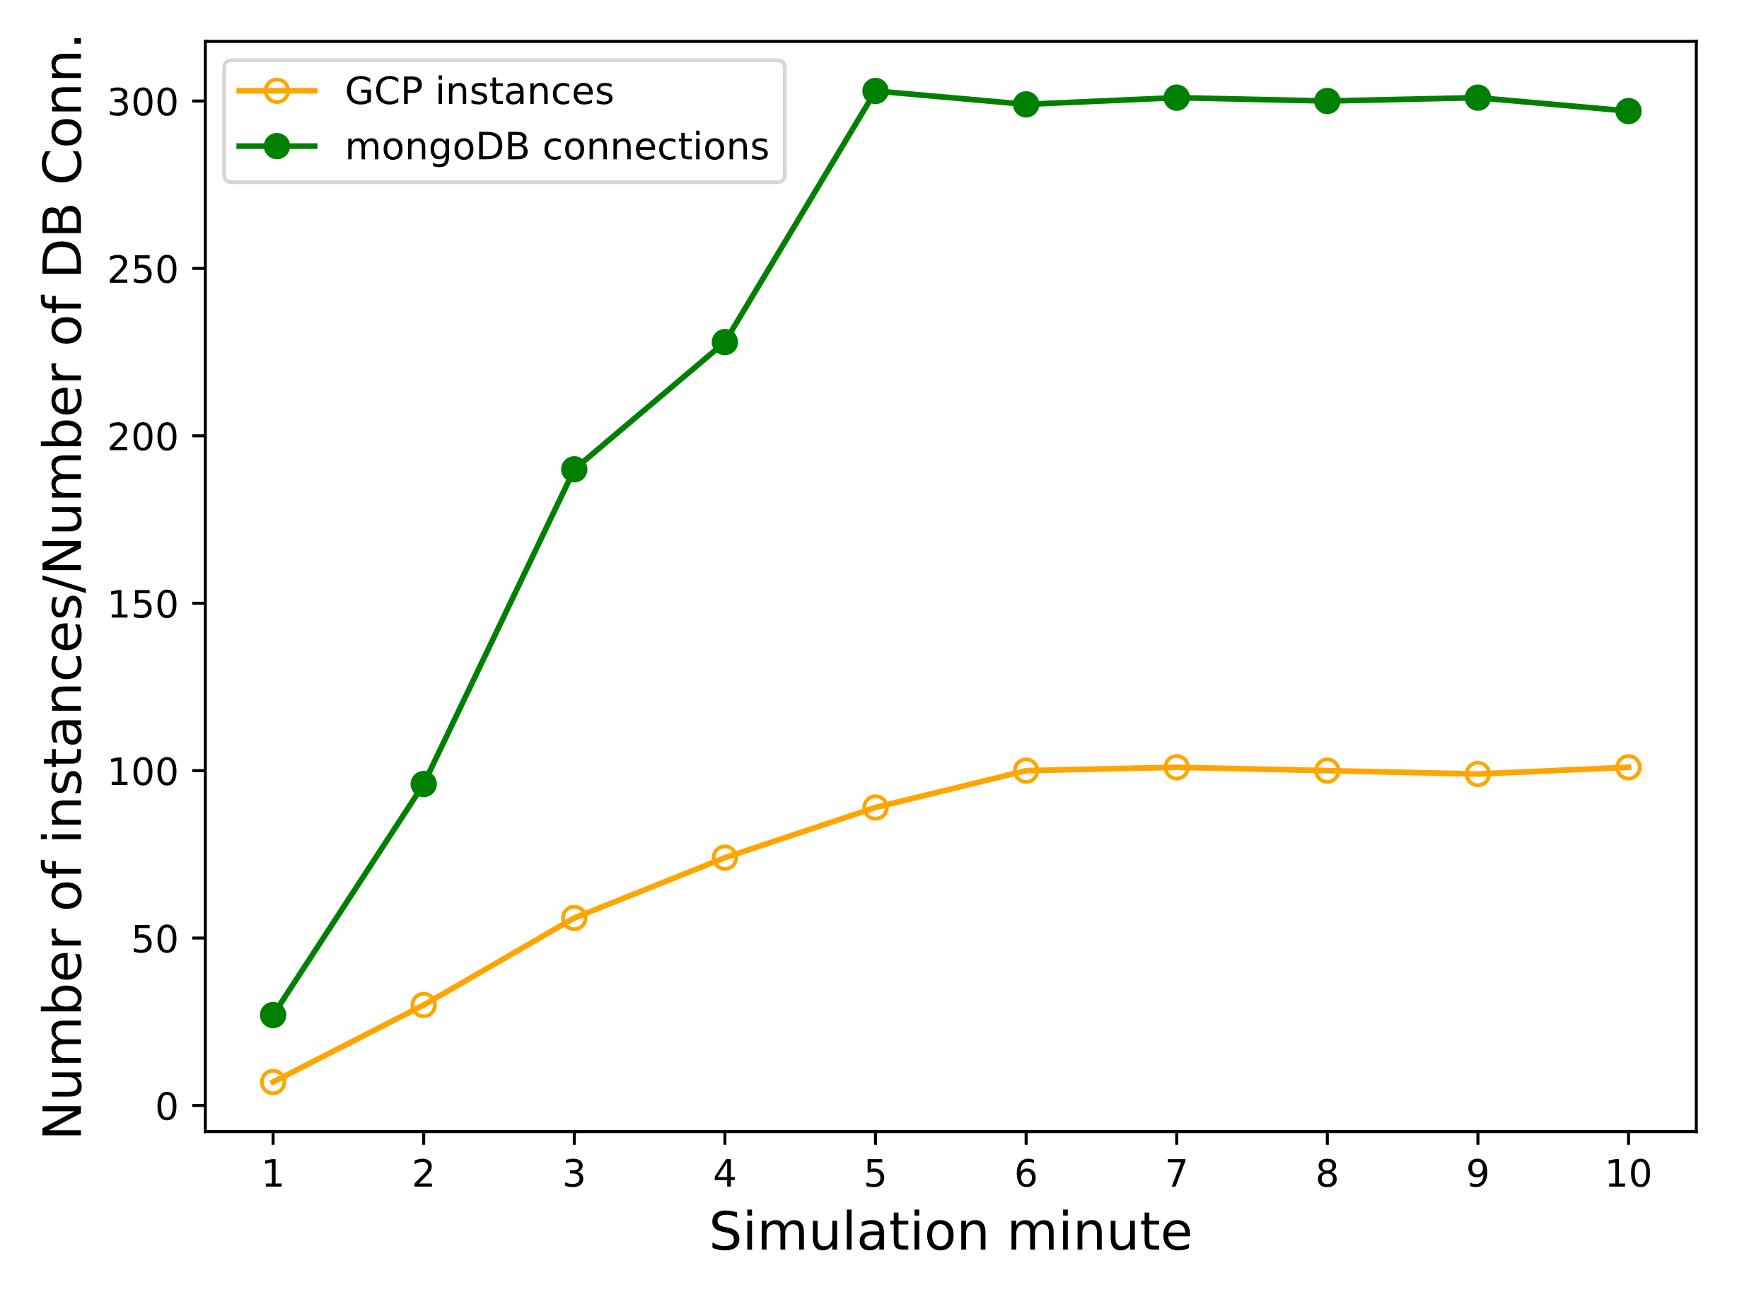
mongoDB Connections Usage Analysis
#ConclusionPack8 – Another architecture-specific vital factor for the pricing; larger allocations produce small amount of DB connections resulting in cost saving for the user

Slide 14
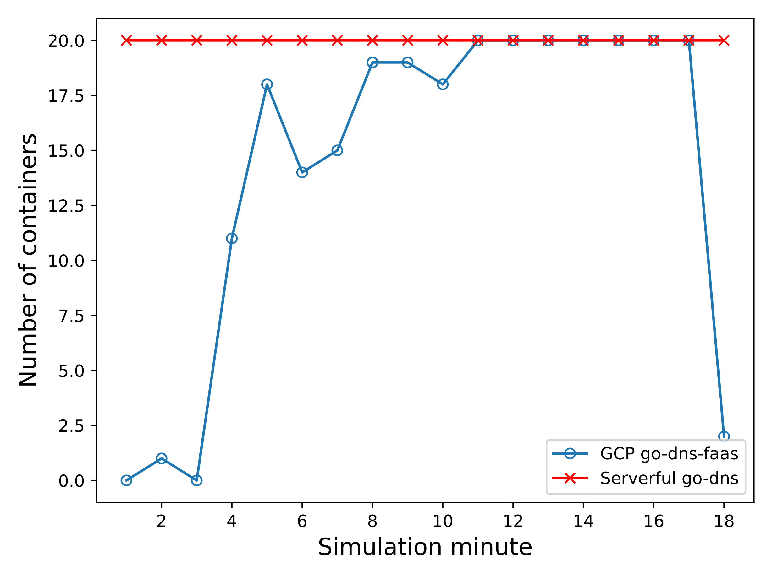
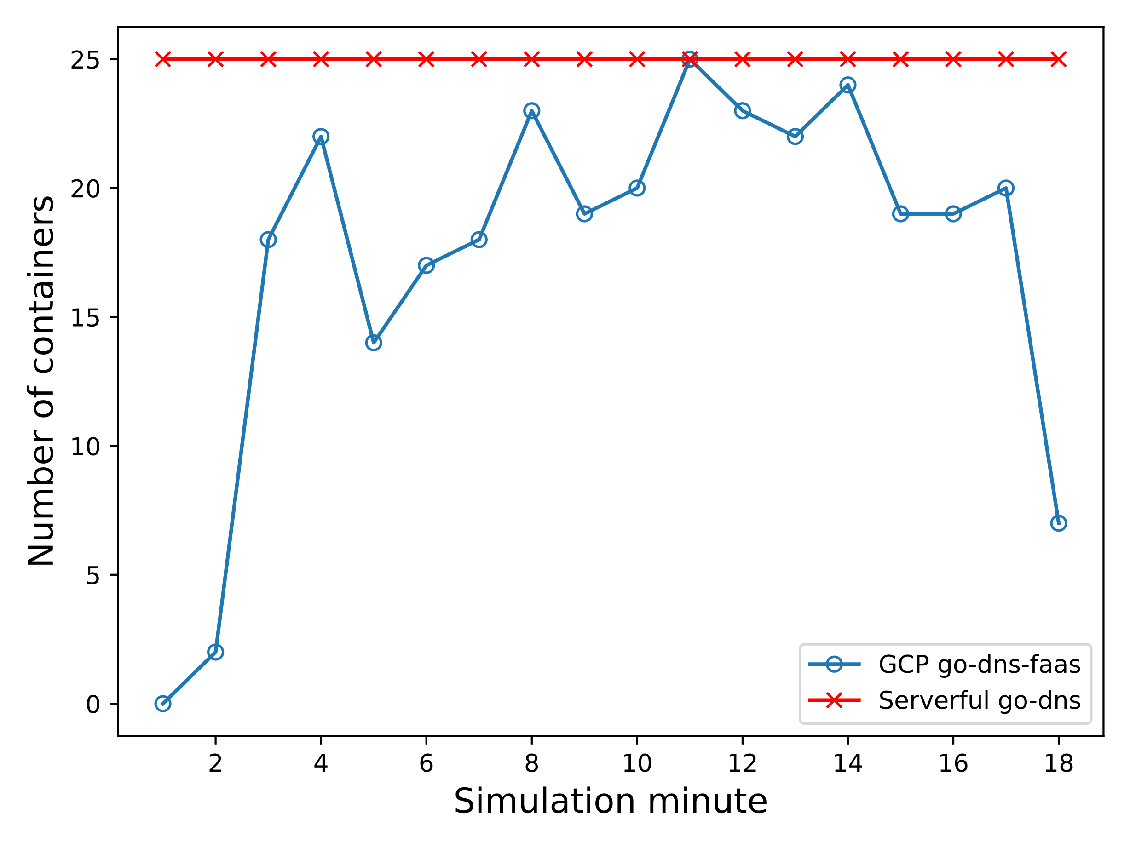
Serverless vs Traditional Computing
#ConclusionPack9 – Serverless solution from a business perspective especially beneficial in case of a spiky workload provided that the end-user is aware of its challenges

Slide 15
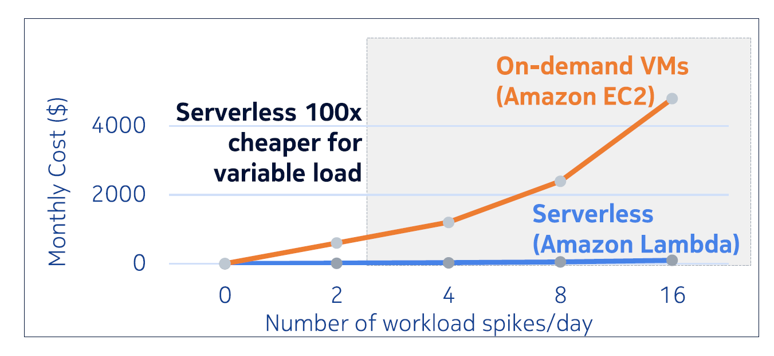
#3 IEEE Explorer verification inspection
P. Aditya et al., "Will Serverless Computing Revolutionize NFV?," in Proceedings of the IEEE, vol. 107, no. 4, pp. 667-678, April 2019, doi: 10.1109/JPROC.2019.2898101.

Slide 16
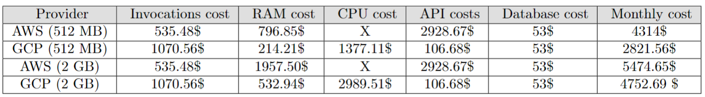
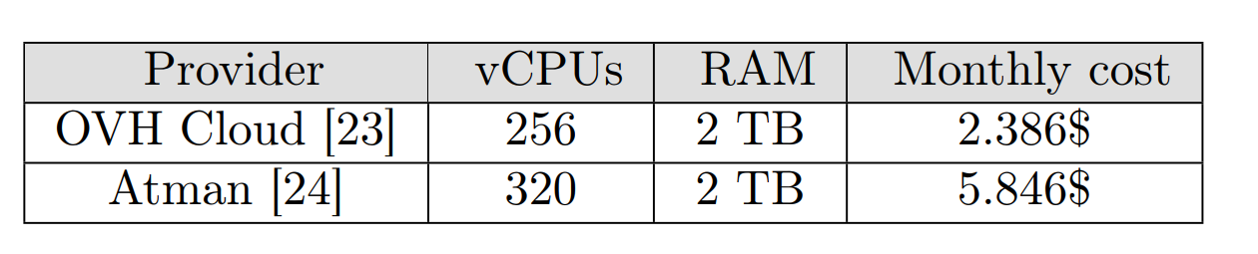
Cost Analysis
#ConclusionPack10 – pay-as-you-go; different billing policies among serverless providers; impact of proper memory allocation, GCP advantage in the researched case

